Slide 1
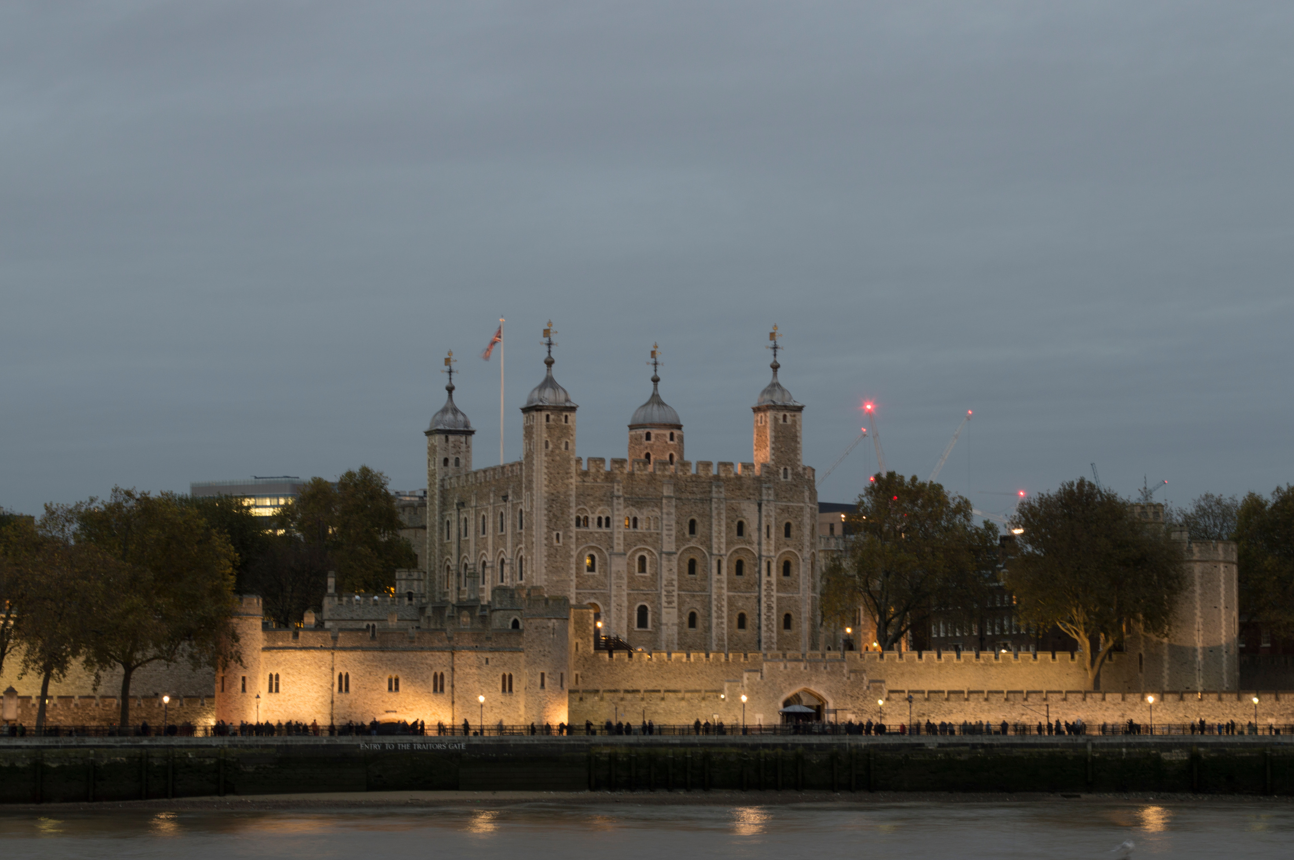



AD 476 to 1500
Chapter 6
THE MIDDLE AGES (NORMAN ENGLAND)
the middle ages (norman england)
Strand Three: The History of Europe and the Wider World
@MsDoorley

Slide 2
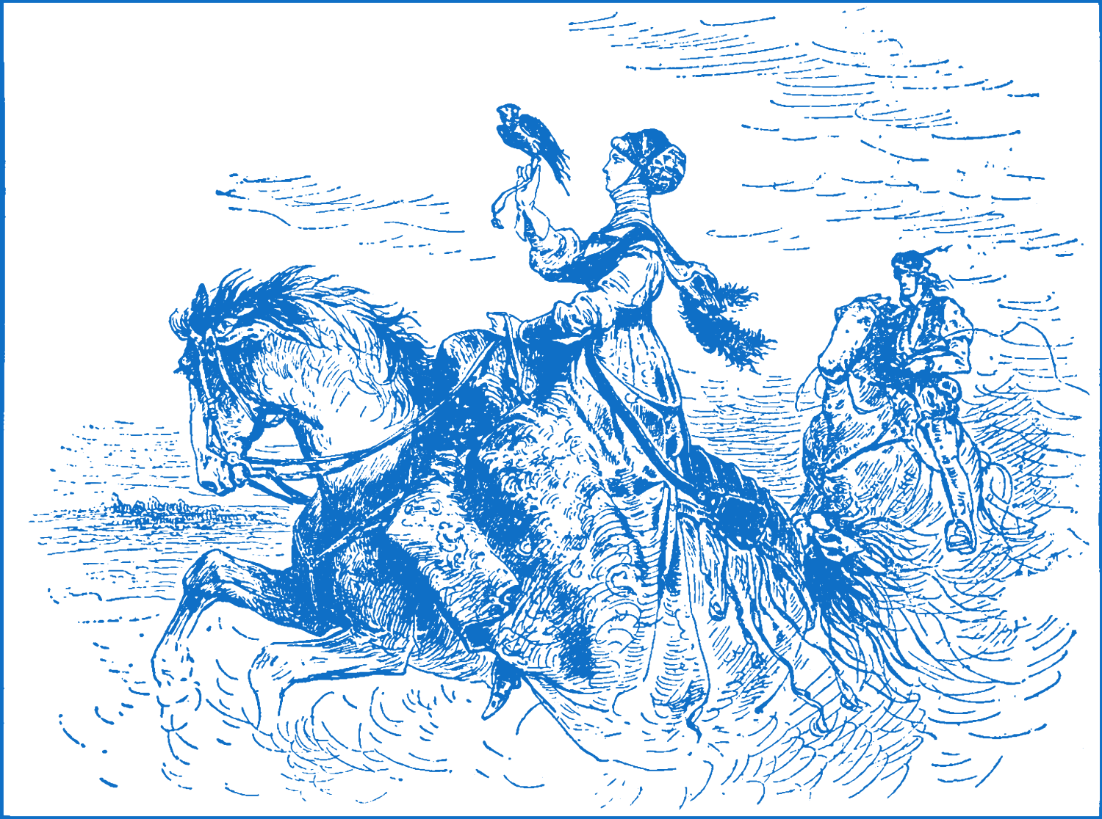
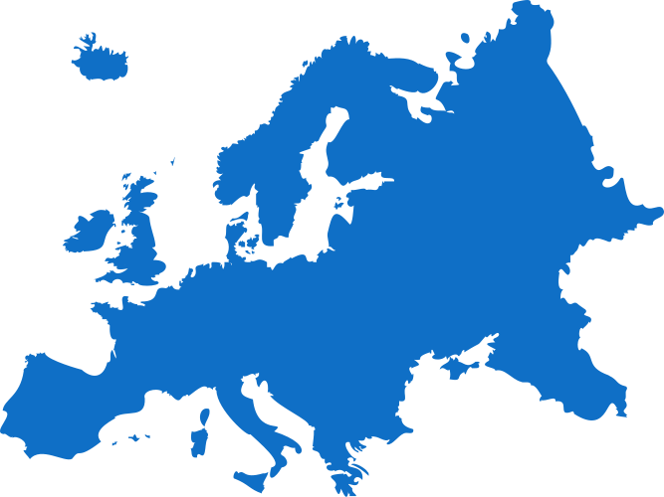
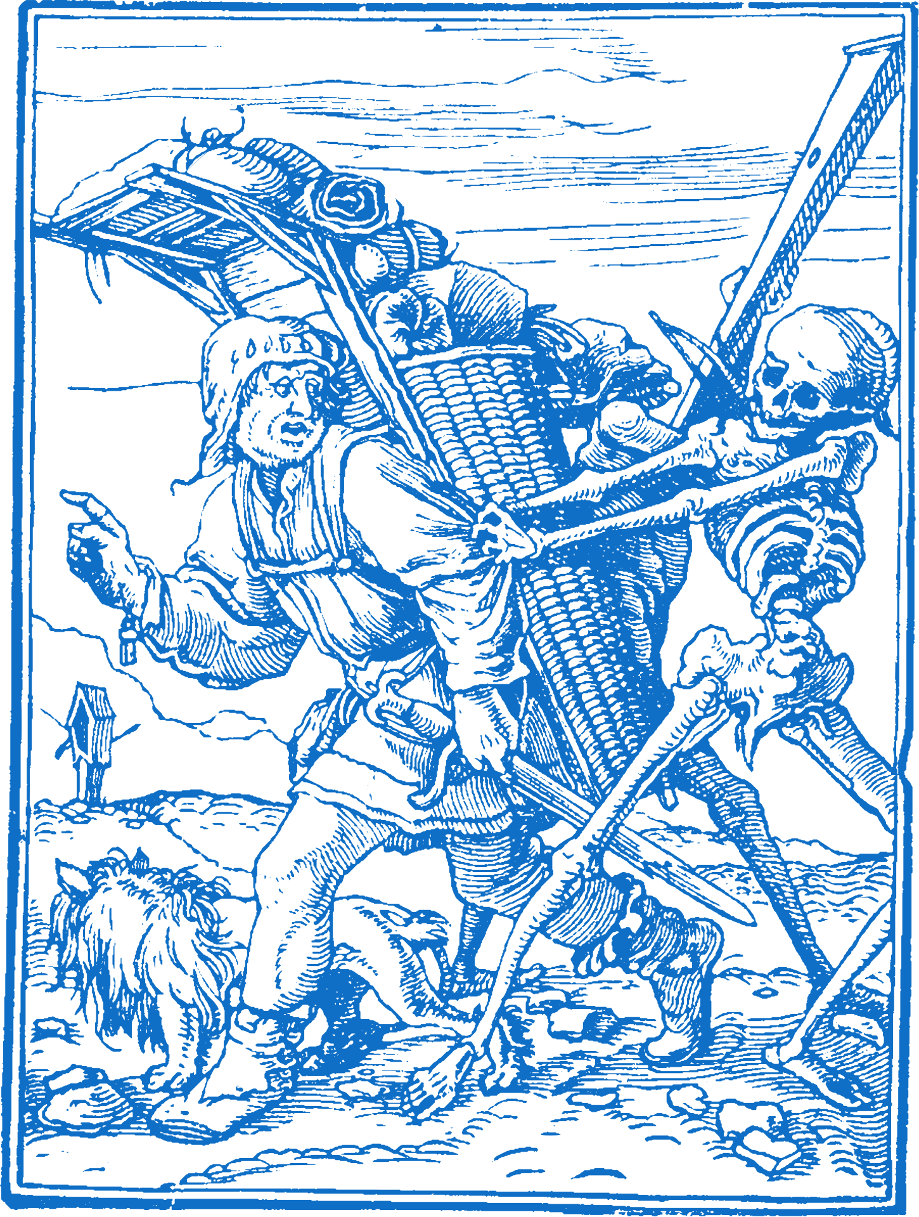
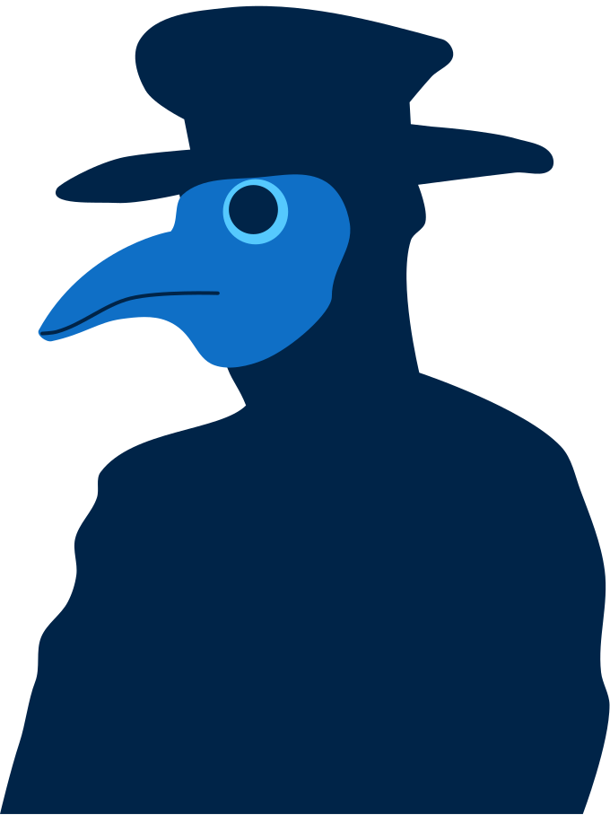
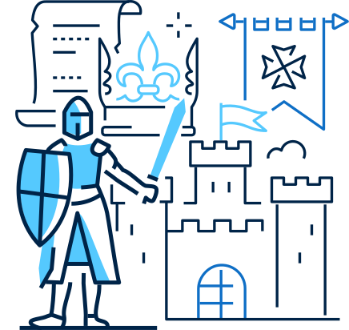
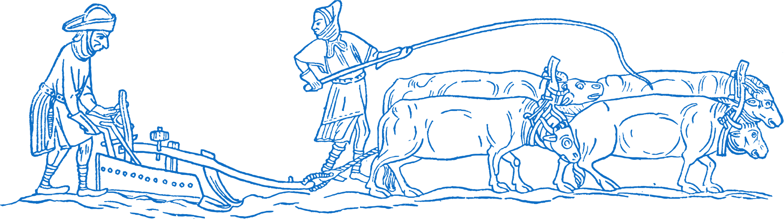
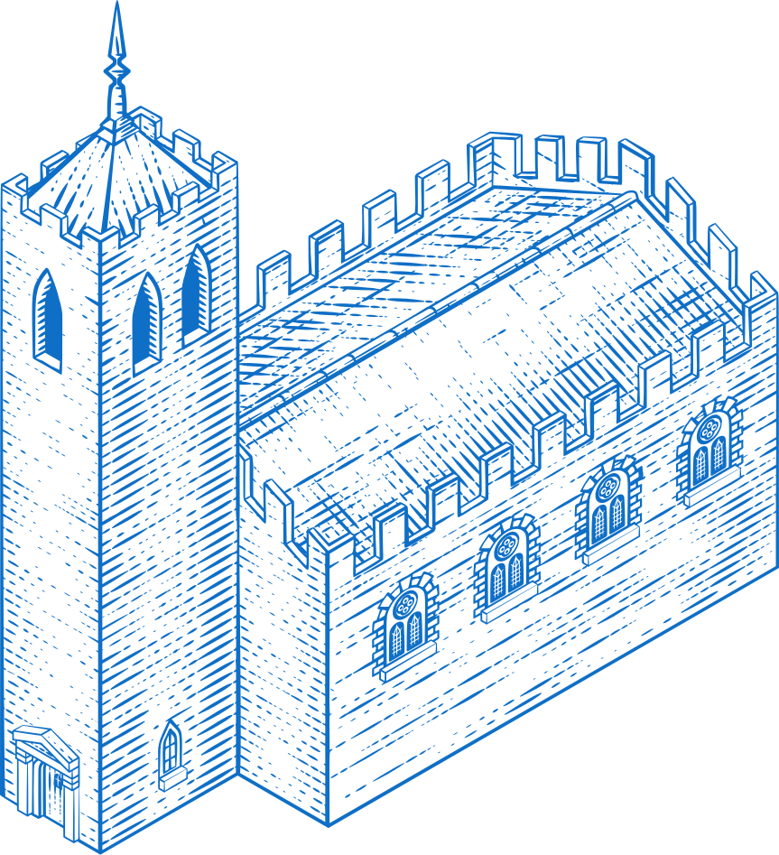


Chapter 6
THE MIDDLE AGES IN NORMAN ENGLAND
3.6 EXPLORE life and death in medieval times
The Holy Roman Empire launches the First Crusade to take back Jerusalem from the Muslim Byzantine Empire. 9 more would follow during the Middle Ages
The Hundred Years War - a struggle between England and France, last 116 years.
The Fall of the Byzantine Empire
The Ottoman Empire captures Constantinople.
The History of Europe and the wider World
Chapter Six: The Middle Ages (Norman England)
476
1099
1215
1337
1347
1453
1500
@MsDoorley
The beginning of the Renaissance marks the end of an era and the beginning of another.
The Fall of the Western Roman Empire.
King John of England signs the Magna Carta, limiting a ruler's power within English law.
The Black Death wiped out a third of Europe's population.

Slide 3
Learning Outcomes
3.1 INVESTIGATE the lives of people in one ancient or medieval civilisation.
3.6 EXPLORE life and death in medieval times.
1.1 DEVELOP a sense of historical empathy by viewing people, issues and events encountered in their study of the past in their historical context.
1.9 DEMONSTRATE awareness of the significance of the history of Ireland and of Europe and the wider world across various dimensions, including political, social, economic, religious, cultural and scientific dimensions.
The History of Europe and the wider World
Chapter Six: The Middle Ages (Norman England)
@MsDoorley

Slide 4
Introduction
The Middle Ages was the period of European history from about 500 to around 1500. It refers to the period between the end of the Roman Empire in the fifth century and the start of the Renaissance in the fifteenth century. It is also called the medieval period. It was a time when war and violence were widespread. Life was difficult, especially for people at the lower levels of society. One of the most powerful groups in medieval Europe was the Normans. This chapter will look at how they organised life in England under the feudal system.
The History of Europe and the wider World
Chapter Six: The Middle Ages (Norman England)
@MsDoorley

Slide 5
AD 476 to 1500
Chapter 6
6.1: THE NORMANS
6.1: the normans
Strand Three: The History of Europe and the Wider World
@MsDoorley

Slide 6
Who were the Normans?
After the fall of Rome, there was no single strong ruler in Europe. Warfare was constant and people looked to local leaders for protection.
The stronger rulers came to control more and more territory and became kings, organising society under the feudal system (a system in which people were given land and protection by people of higher rank, and worked and fought for them in return).
The Normans were among the most powerful of these groups.
While the Vikings were settling in Ireland, they were also settling along north-west France (also known as Norsemen). The area where they lived became known as Normandy.
In 1066, the King of England, Edward the Confessor, died without an heir. William, the duke of Normandy, claimed the English Crown – but this was rejected by the English nobles, led by Harold, the Earl of Hereford.
William invaded England and defeated Harold at the Battle of Hastings (1066), making him the King of England. He became known as William the Conqueror.
He and his successors spent the next century establishing their control over England and Wales. The story of the Norman Conquest is told in the Bayeux Tapestry.
By 1200, different groups of Normans had set out to conquer many different parts of Europe, eventually controlling land in England, Ireland, France, Italy, Tunisia, Libya and the Middle East.
The History of Europe and the wider World
Chapter Six: The Middle Ages (Norman England)
@MsDoorley

Slide 7
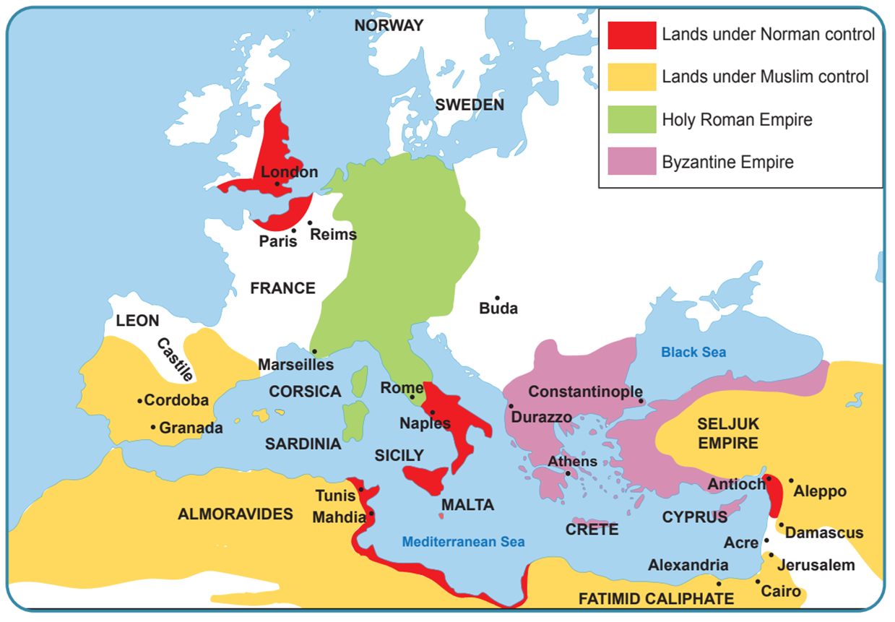
The History of Europe and the wider World
Chapter Six: The Middle Ages (Norman England)
Diagram taken from Artefact, 2nd Edition by Eimear Jenkinson and Gregg O'Neill (educate.ie)
@MsDoorley

Slide 8
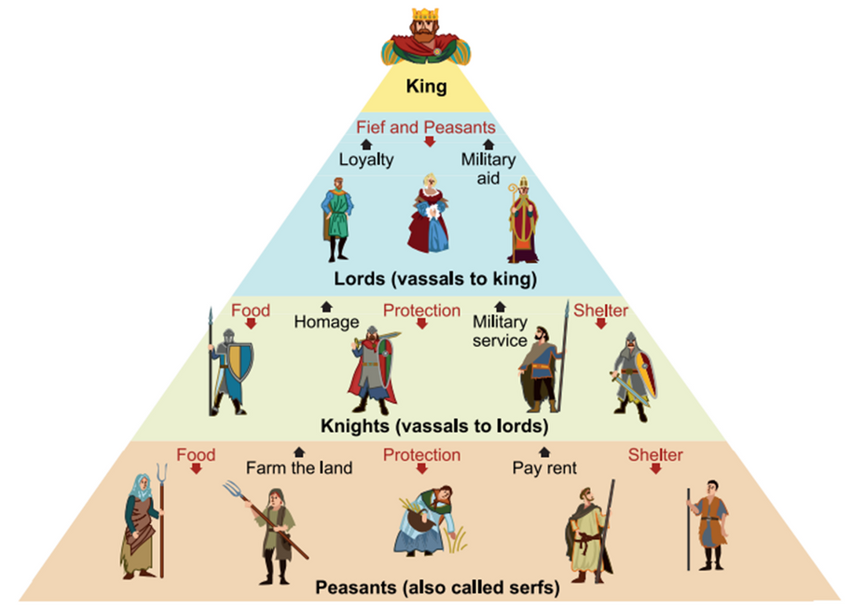
Feudalism
Land was the most important form of wealth during the Middle Ages. The ownership of land was organised by a feudal system (a system in which people were given land and protection by people of higher rank, and worked and fought for them in return).
The King owned all the land in the country and made the laws – he gave an area of land called a fife to rich nobles (lords and barons).
Nobles promised to be loyal to the king, supplying him with soldiers and horses for his army. These nobles gave some land to professional soldiers (knights).
In return, these Knights obeyed the king’s rules, fighting for their King and lord.
There were two kinds of peasants who worked the land for nobles and knights. Those who rented the land were called freemen. They were given protection from for their work. The others were serfs, who were a little better than slaves.
The History of Europe and the wider World
Chapter Six: The Middle Ages (Norman England)
Diagram taken from Artefact, 2nd Edition by Eimear Jenkinson and Gregg O'Neill (educate.ie)
@MsDoorley

Slide 9
Checkpoint (pg. 39, Artefact, 2nd Edition)
  From where did the Normans originate?
  When did they conquer England?
  Name three other countries that the Normans controlled.
  Explain the following term: peasants, vassals, fief, oath of fealty
  Explain, with the aid of a diagram, the feudal system.
The History of Europe and the wider World
Chapter Six: The Middle Ages (Norman England)
@MsDoorley

Slide 10
Checkpoint (pg. 39, Artefact, 2nd Edition)
  Normandy, north-west France.
  The Battle of Hastings or 1066
  Any three of: Ireland, France, Italy, Tunisia, Libya and the Middle East.
    Peasants: people who worked on a lord’s land.
    vassals: people who follow a king as his ‘subjects’, obey the rules of a king, loyal to a king
    fief: a plot of land controlled by a lord or noble that was given to him by a king
    oath of fealty: swearing loyalty to a king or noble, promising to fight for them in war
  A pyramid with a king/queen on top and under them the lords, then the knights, then the peasants.
The History of Europe and the wider World
Chapter Six: The Middle Ages (Norman England)
@MsDoorley

Slide 11
AD 476 to 1500
Chapter 6
6.2: LIFE IN A NORMAN CASTLE
6.2: life in a norman castle
Strand Three: The History of Europe and the Wider World
@MsDoorley

Slide 12
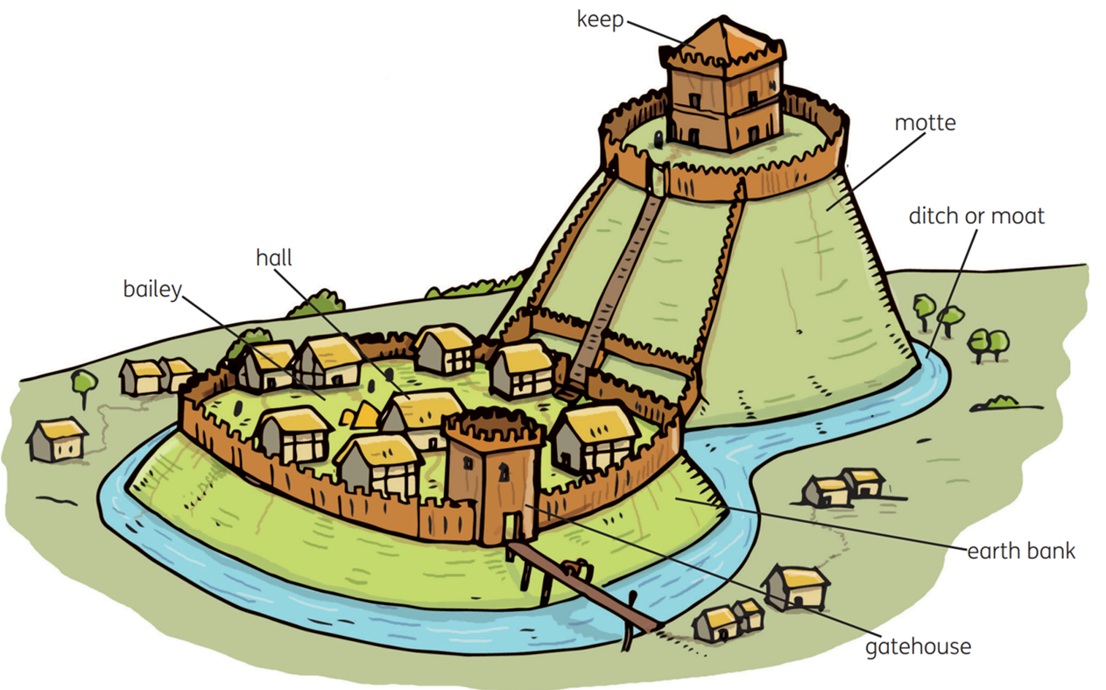
Building Castles
The Normans needed a way to control their newly conquered territory and people. William the Conqueror divided the land among his followers, who became his vassals. In order to take control of his new fief quickly, a lord would build a temporary castle called a motte and bailey. A motte was a small artificial hill with a wooden tower or keep at the top. Below this hill was a large enclosed area where the soldiers lived (bailey), surrounded by high wooden fences and a ditch/moat.
Once his control of an area was secured, the lord would build a permanent stone castle. These castles allowed the lord to defend attacks and run the land given to him by the king.
The History of Europe and the wider World
Chapter Six: The Middle Ages (Norman England)
Diagram taken from Artefact, 2nd Edition by Eimear Jenkinson and Gregg O'Neill (educate.ie)
@MsDoorley

Slide 13
The History of Europe and the wider World
Chapter Six: The Middle Ages (Norman England)
Diagram taken from Artefact, 2nd Edition by Eimear Jenkinson and Gregg O'Neill (educate.ie)
@MsDoorley

Slide 14
Stone Castles
Medieval stone castles were huge fortifications. It took several hundred men working for several years to complete one. A typical castle had the following key parts:
  The curtain walls enclosed the castle and protected those inside.
  The keep was the main building inside the walls. It held the lord's apartments, the great hall and a chapel. The windows were narrow to keep in the heat and to make defence easier.
  Below the keep were the dungeons, used to keep stored food cool and to hold prisoners.
  Battlements ran along the top of the keep and the walls. Soldiers would patrol along them day and night. Towers/turrets were built into the walls at regular intervals, especially at corners.
  The enclosed area around the keep was called the bailey. Here the stables, workshops, kitchen, well for water and soldiers' lodgings were situated. If the castle was under attack, animals and people from the surrounding area could be brought inside for their protection.
  In the gatehouse, the drawbridge and the portcullis were found. The drawbridge could be raised and lowered to control entry to the castle. It was raised at night and if the castle was under attack. The portcullis was a metal grid that could be lowered over the gate if necessary.
  The castle was surrounded by a deep ditch filled with water, called the moat.
The History of Europe and the wider World
Chapter Six: The Middle Ages (Norman England)
@MsDoorley

Slide 15
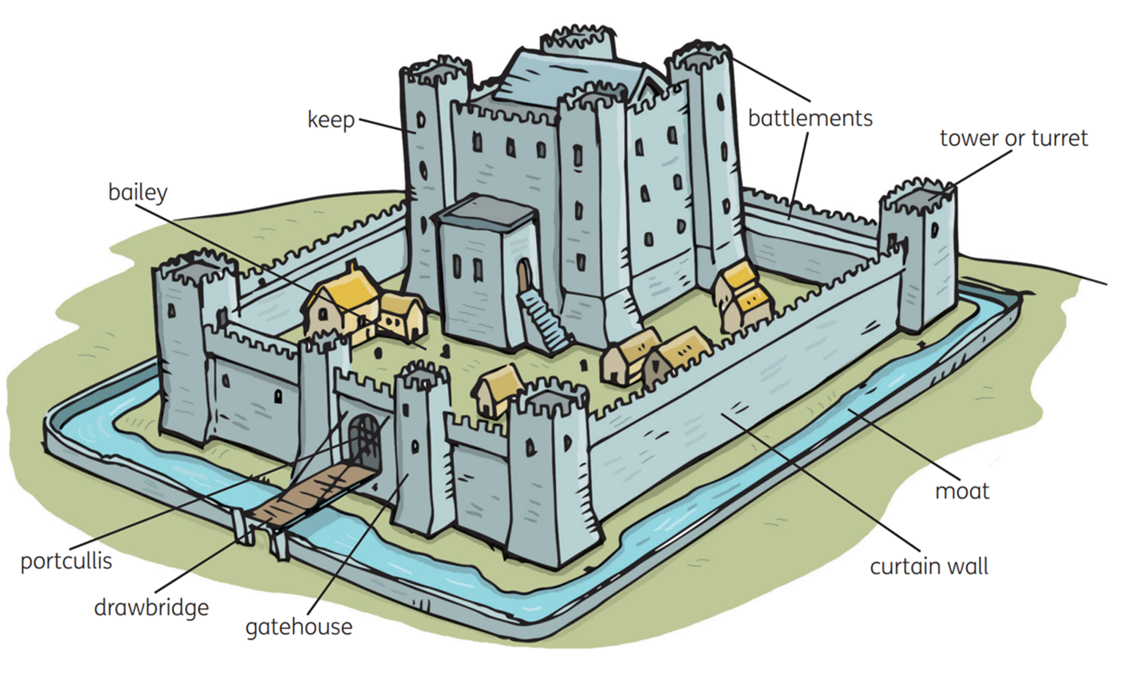
The History of Europe and the wider World
Chapter Six: The Middle Ages (Norman England)
Diagram taken from Artefact, 2nd Edition by Eimear Jenkinson and Gregg O'Neill (educate.ie)
@MsDoorley

Slide 16
Castles and War
Warefare was widespread during the Middle Ages. Castles were key to the defence of a lord's lands and a kingdom generally. Their high walls and well-armed soldiers and knights made them a difficult target. Even if an attacking army surrounded the castle and waited for surrender (a siege), the castle could hold out for a long time once it had enough food stores and a well. Defenders could fire arrows from the walls, or pour boiling hot water/oil down on the attackers. Castles were often built on hills or beside rivers to add to their defences.
Laying siege to a castle could be difficult and time-consuming, so the attacking army used various means to try to breach the castle's walls, such as catapult and siege towers. If these tactics failed, attackers would tunnel under the castle's walls to undermine them. Gunpowder was brought to Europe from China in the 1400s and the cannon was invented. This meant that a castle's walls could be easily and quickly destroyed and they were no longer key to warfare.
The History of Europe and the wider World
Chapter Six: The Middle Ages (Norman England)
@MsDoorley

Slide 17
Checkpoint (pg. 50, Artefact, 2nd Edition)
  Why were castle built in the Middle Ages?
  Describe a motte and bailey castle.
  What were the main defensive features of a castle?
  Why were castles so difficult to capture?
The History of Europe and the wider World
Chapter Six: The Middle Ages (Norman England)
@MsDoorley

Slide 18
Norman Lords and Ladies
A Norman lord was very powerful; he owned huge areas of land and commanded many knights and soldiers. A Norman lady usually married at a young age. Marriages were arranged by the two families, often to seal an alliance. A dowry (sum of money or land) was paid to the groom.
The lady's main duty was to bear children as heirs. The family lived upstairs in the keep, near the chapel and a warm sunny room called a solar. Here, the lady would weave, teach the children or play music. She also ran the household, instructing the servants, supervising the storage and preparation of food and acting for her husband when he was away. The lord's duties were to maintain order in his lands, act as a judge and train soldiers. In his leisure time, he went hunting or hawking and held tournaments (events for knights) featuring mock battles and jousting contests.
Feasts were held in the great hall, which had big fireplaces and tapestries on the walls. Beef, pork, mutton, duck, deer, pheasant or rabbit were served - either farm animals or what the lord caught while hunting. Without refrigeration, meat could not be kept fresh for long. People salted, smoked or dried meat and fish while using herbs and spices to vary the strong flabour. Spices were very expensive as they had to be transported from Asia. Forks were not yet used in Europe, and instead of plates people often ate from large pieces of hard bread called trenchers. Minstrels (musicians) and jesters (comic preformers) provided entertainment.
Men wore long tunics and trousers of fine wool or linen and women wore full-length dresses. Clothing that was embroidered or dyed in vivid colours showed off the wearer's wealth. The richest nobles wore silk brought from Asia.
The History of Europe and the wider World
Chapter Six: The Middle Ages (Norman England)
@MsDoorley

Slide 19
Checkpoint (pg. 51, Artefact, 2nd Edition)
  How were marriages arranged between nobles?
  What was a solar?
  What was the role of the lady of the castle?
  How did the lord spend his time?
  Describe a medieval feast.
  Wealth and status were very important. Name two ways that a lord could display his wealth.
The History of Europe and the wider World
Chapter Six: The Middle Ages (Norman England)
@MsDoorley

Slide 20
AD 476 to 1500
Chapter 6
6.3: SOLDIERS IN THE MIDDLE AGES
6.3: soldiers in the middle ages
Strand Three: The History of Europe and the Wider World
@MsDoorley

Slide 21
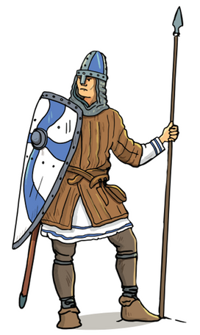
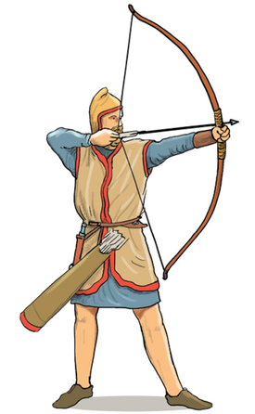
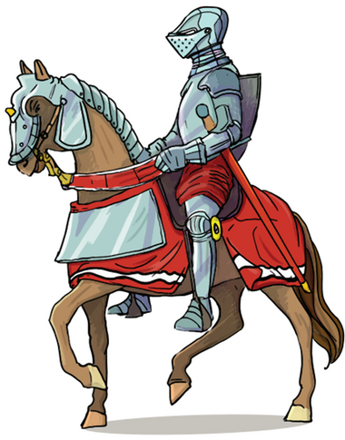
Medieval Soldiers
The Norman army that conquered England was made up of three main types of soldiers:
Foot soldiers made up the largest part of any medieval army. They fought with swords, daggers and spears.
For protection, they had shields and leather padded jackets. Made up by peasants who returned to the fields once the battle/war was over.
Archers fought with a bow and arrow, or sometimes used a longbow or crossbow. They wore little protective clothing. Norman archers from England were considered the best in Europe and gave their lords an advantage in battles (hence why Robin Hood was depicted as an archer).
Knights were minor nobles who fought on horseback and swore an oath of chivalry. They wore full body armour (plate armour), chainmail, a shield and helmet for protection. They fought with lances, swords and maces. There were only a few hundred knights in the Norman army, but they proved to be decisive in winning the Battle of Hastings in 1066.
The History of Europe and the wider World
Chapter Six: The Middle Ages (Norman England)
Diagram taken from Artefact, 2nd Edition by Eimear Jenkinson and Gregg O'Neill (educate.ie)
@MsDoorley

Slide 22
The training of a knight
There were two ways for a man to become a knight. If a foot soldier showed exceptional bravery on the battlefield, he could be knighted by a lord. However, this was very rare and the main way was a three-stage process followed by the sons of nobles.
Stage 1: Page
At the age of seven, a boy would be sent to live with the family of another lord; this was known as fostering. He would learn to ride a horse, use a sword, sing and dance. He was taught manners, helped the lady of the castle and swerved the lord and lady at table.
The History of Europe and the wider World
Chapter Six: The Middle Ages (Norman England)
Stage 2: Squire
Aged fourteen, the boy began learning to fight on horseback. He would accompany the lord into battle, look after his horse and weapons and help the lord dress for battle and tournaments.
Stage 3: Knight
At twenty-one, he was eligible to become a knight. He spent the night before the ceremony in prayer in the chapel. Then, dressed in a white robe and full armour, he took part in the ceremony of dubbing. He swore an oath of chivalry (to stay loyal to his lord, protect the poor and weak, and to be brave in battle) and the lord touched him on both shoulders with a sword and told him, 'Arise, sir knight'.
@MsDoorley

Slide 23
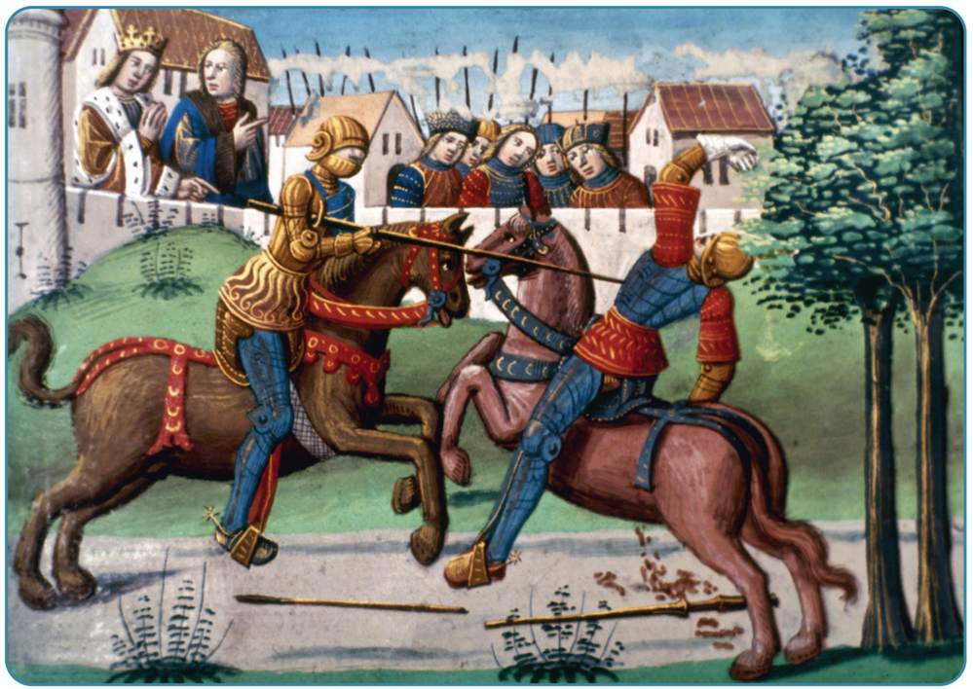
Life of a knight
The lord would give a manor to the knight to manage. When he was not fighting in real wars and battles, the knight would often take part in tournaments. These featured mock battles, fought with wooden weapons, and jousting matches, where two knights on horseback rode straight at each other and each tried to knock his rival off his horse using a lance.
The History of Europe and the wider World
Chapter Six: The Middle Ages (Norman England)
Diagram taken from Artefact, 2nd Edition by Eimear Jenkinson and Gregg O'Neill (educate.ie)
@MsDoorley

Slide 24
Checkpoint (pg. 53, Artefact, 2nd Edition)
  Name three differences between a foot soldier and a knight.
  Why do you think that foot soldiers and archers had very little protection?
  Explain what happened at the page and squire stages of becoming a knight.
  Explain the following terms: fostering; dubbing; oath of chivalry.
  Why do you think knights engaged in tournaments?
The History of Europe and the wider World
Chapter Six: The Middle Ages (Norman England)
@MsDoorley

Slide 25
AD 476 to 1500
Chapter 6
6.4: LIFE IN THE NORMAN COUNTRYSIDE
6.4: life in the norman countryside
Strand Three: The History of Europe and the Wider World
@MsDoorley

Slide 26
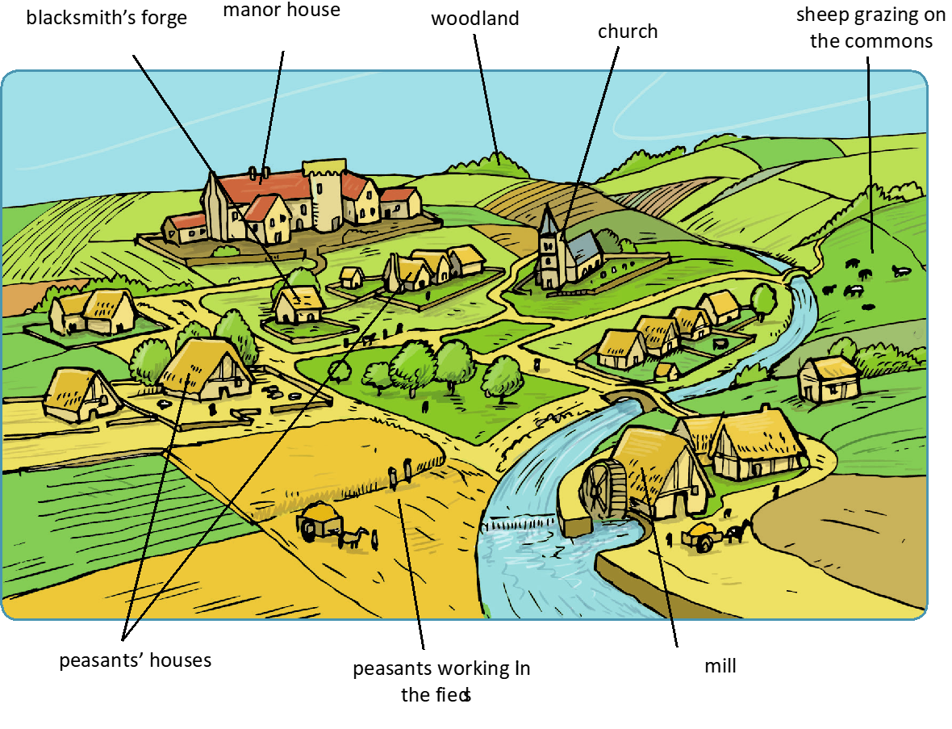
The History of Europe and the wider World
Chapter Six: The Middle Ages (Norman England)
Diagram taken from Artefact, 1st Edition by Eimear Jenkinson and Gregg O'Neill (educate.ie)
@MsDoorley

Slide 27
Life in a medieval manor village
The vast majority of people in the Middle Ages lived in the countryside. Most were peasants (people who worked on a lord’s land) and lived in villages called manors that were owned by a lord or knight. Each manor was quite small, usually made up of about 50 houses for the peasants, as well as the manor house for the lord or knight and the church for the local priest.
A manor usually had a mill for grinding wheat to make bread, a blacksmith's forge to make tools and weapons and a house for the bailiff, the man who ran the manor in the lord's absence. He was responsible for collecting taxes and keeping law and order in the village.
Most manors had woodland around them. The peasants could collect wood here to build their homes and make fires. However, they were strictly forbidden to hunt the animals in the forest and they would face very harsh punishments - such as lousing a hand - if they were caught! Only the lord was allowed to hunt in the forest.
The History of Europe and the wider World
Chapter Six: The Middle Ages (Norman England)
@MsDoorley

Slide 28
Medieval Farming
Farming was the main occupation of the peasants on a medieval manor. They used the open field system of farming:
The land for crops was divided into three huge fields. Each field was divided into long strips of land and tended by different families. Each family had strips in each of the three fields.
They practised crop rotation – the crop in each field was changed every year. For example:
  Field One – wheat for making bread
  Field Two – oats for making porridge, barley for making beer
  Field Three was left fallow (empty) for one year so that the soil could recover its nutrients.
  A fourth large field, called The Commons, was used for animal grazing.
The History of Europe and the wider World
Chapter Six: The Middle Ages (Norman England)
 | Field 1 | Field 2 | Field 3
Year 1 | Wheat | Oats and Barley | Fallow
Year 2 | Oats and Barley | Fallow | Wheat
Year 3 | Fallow | Wheat | Oats and Barley
@MsDoorley

Slide 29
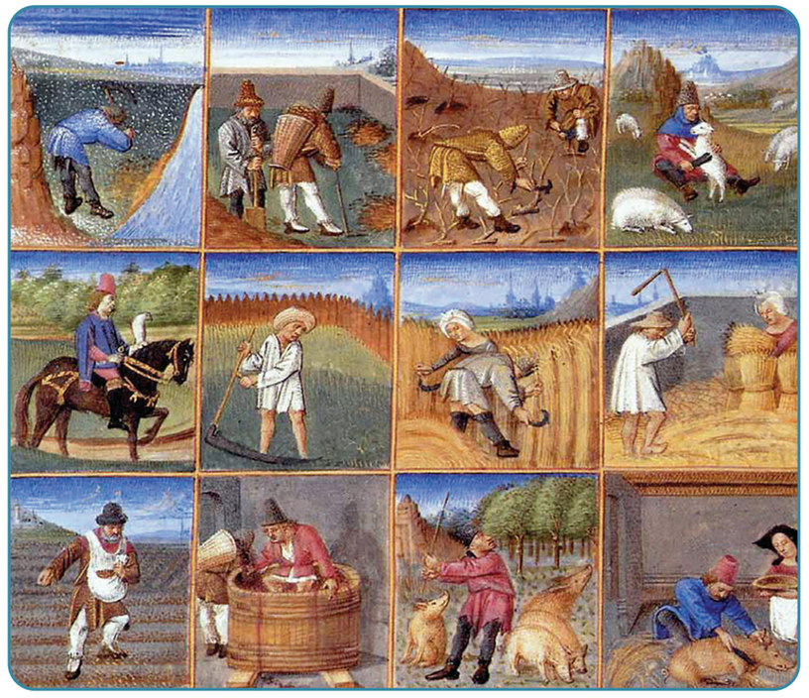
Peasants: Freeman vs Serfs
There were two kinds of peasants in the Middle Ages: freeman and serfs.
Freemen had to pay rent and a tithe (a tenth of their income to the local priest) but they did not have to work the land for free. They were also able to marry whoever they wished and leave the manor.
Serfs, on the other hand, essentially belonged to their Lord and were a little better off than slaves. They worked six days a week farming a lord's land. In return they recieved a small plot of land to farm and build a house on. They could not leave the manor or marry without the lord's permission. They paid taxes to the lord and a tithe to the priest. They also had to work without pay for several days each year (boon work) on the lords demesne (private land). If a serf escaped and stayed free for a year and a day, he became a freeman.
The History of Europe and the wider World
Chapter Six: The Middle Ages (Norman England)
Diagram taken from Artefact, 2nd Edition by Eimear Jenkinson and Gregg O'Neill (educate.ie)
@MsDoorley

Slide 30
How serfs lived
A serf’s home was tiny – a single room build with wattle and daub with a thatched roof. Outside they grew vegetables and kept a few animals. Inside was cramped, dark and smoky from the fire. At night, the animals were kept inside for warmth and safety. Men wore tunics and leggings while women wore long dresses with a head scarf. Their shoes were made from leather. All clothing was handmade, of wool or lined, and dyed using berry juice.
For food, a serf family had only what they could produce from their small plot. Their main diet consisted of bread, cheese, and a vegetable-oat soup called pottage. They drank ale (a weak beer made from barley) because it was safer than water. They ate meat very rarely, possibly only at Christmas and Easter.
A female serf looked after the home, cooked, made clothes and reared the children until they were old enough to work in the fields with their father. The only leisure time was on Sundays and the various saints' days. On these days, after Mass, there was singing and dancing, drinking and village games.
They faced many dangers such as famines (these were common in medieval times and it was the peasants who went hungry) and wars between lords (which were so common that the priest had to ban fighting on certain days of the year (Truce of God)).
The History of Europe and the wider World
Chapter Six: The Middle Ages (Norman England)
@MsDoorley

Slide 31
Checkpoint (pg. 50, Artefact, 2nd Edition)
  What crops were grown in the manor’s fields and what was made from them?
  The Church and the manor house were usually the only stone buildings. Why do you think this was?
  Explain the following terms; tithe; open field system; fallow; commons; bailiff.
  Name two difference between a serf and a freeman.
  Describe a serf’s house.
  What was a peasant’s clothes made from?
  What different types of work were done by male and female serfs?
  Describe leisure time for a serf.
The History of Europe and the wider World
Chapter Six: The Middle Ages (Norman England)
@MsDoorley

Slide 32
Checkpoint (pg. 50, Artefact, 2nd Edition)
  Oats – porridge and pottage; wheat – bread; barley – beer.
  The church and the manor house were usually the only stone buildings because stone was more expensive to build with and the lord and priest were the only ones who could afford it.
    Open field system: peasants farmed the land in large open fields divided into strips of crops for each family.
    Fallow: leaving one field of three empty each year to allow it to regain its nutrients.
    Commons: large field in the manor used to graze the animals of the peasants.
    Tithe: tax on peasants – one-tenth of their income went to the local priest.
  Any two of: Serfs needed permission to marry, freemen did not; freemen could leave the manor at will, serfs could not; freemen paid rent to the lord instead of working for free on his land.
  A serf lived in a small one-room house with wattle and daub walls, an earthen floor and a thatched roof.
  A peasant’s clothes were handmade from wool or linen.
  Male serfs worked in the fields and hunted; female serfs looked after the house, cooked, made clothes, looked after their children and small animals such as chickens and goats.
  On Sundays and holy days, there would be village games (such as wrestling), drinking, singing and dancing.
The History of Europe and the wider World
Chapter Six: The Middle Ages (Norman England)
@MsDoorley

Slide 33
AD 476 to 1500
Chapter 6
6.5: LIFE IN A NORMAN ENGLISH TOWN
6.5: life in a norman english town
Strand Three: The History of Europe and the Wider World
@MsDoorley

Slide 34
Medieval Towns
Towns in Norman England and around Europe in the Middle Ages were much smaller than towns today. Most had only about 1,000 people and the largest had only about 5,000 people. Many were built on rivers, on the coast, where roads met so that people could make money from trade. Sometimes they were build near castles for protection and to cater to the needs of the castle. A town needed a charter, which was special permission or contract from the King or Queen where the town was granted the freedom to run its own affairs but had to pay taxes to the king.
A corporation and a mayor ran the town. They kept the walls in good repair, tried to deal with dirt and sweage, paid town guards and enforced the curfew and other laws of the town.
The History of Europe and the wider World
Chapter Six: The Middle Ages (Norman England)
@MsDoorley

Slide 35
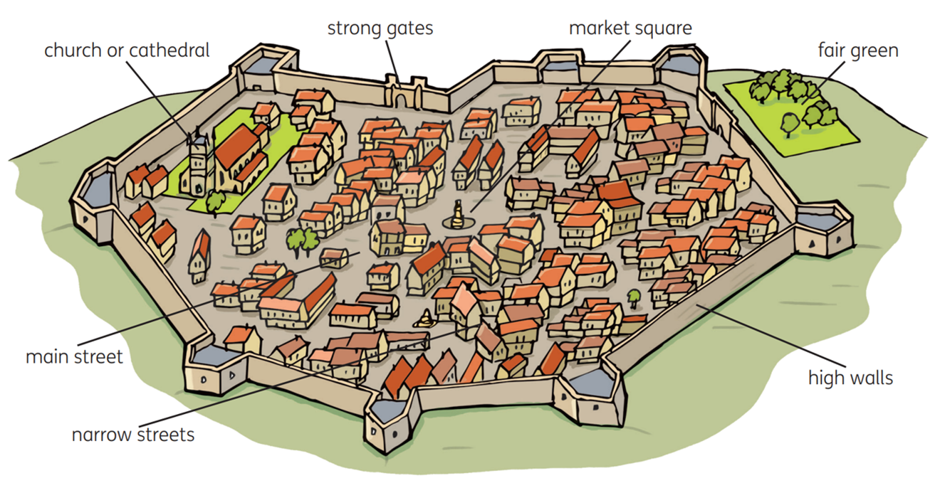
The History of Europe and the wider World
Chapter Six: The Middle Ages (Norman England)
Diagram taken from Artefact, 2nd Edition by Eimear Jenkinson and Gregg O'Neill (educate.ie)
@MsDoorley

Slide 36
Medieval Towns
Every town was different, but they all shared common features:
  Towns had high walls to protect them against attacks.
  Strong gates were the only way in and out of the town. The gates were opened at dawn and closed at sundown. Anyone who wanted to come into the town to conduct business (especially to sell goods) had to pay a toll (a tax on entry) at the gates.
  The main or high street ran from the main gates to the market square in the middle of the town. This was the only street that was wide and paved with stones or wooden planks. The richest people had their houses here.
  Narrow streets ran off the main street and these contained houses and shops for the townspeople.
  Larger towns had several churches and even a cathedral, if a bishop was based there.
  Outside the walls was the fair green for the annual fair. This was a huge market where traders from all over the country sold exotic things like silks and spices, as well as tools and weapons.
The History of Europe and the wider World
Chapter Six: The Middle Ages (Norman England)
@MsDoorley

Slide 37
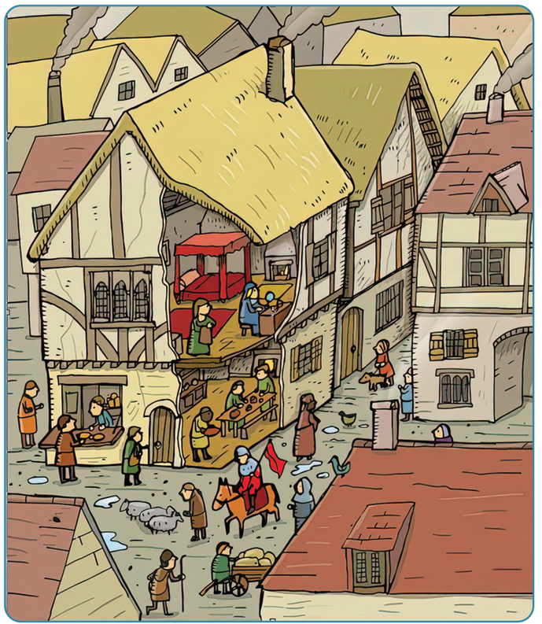
Medieval Houses
The average person's house was made of wood. They were usually several storeys high. The higher floors usually stuck out over the street, which blocked the sun and made the streets very dark. Only important buildings - the church or town hall and richer people's homes - were made of stone. Craftsmen had their shops or workshops on the ground floor, with their family living on the floors above. Houses had no toilets; instead, people used chamber pots.
Many houses had back gardens where people grew vegetables and kept animals such as pigs, hens and cows. People kept dung heaps in their gardens where they threw some of their waste, especially foot waste.
Fire was a constant danger, due to all the wooden buildings. Towns imposed curfews, which meant people had to extinguish their fires at sundown.
The History of Europe and the wider World
Chapter Six: The Middle Ages (Norman England)
Diagram taken from Artefact, 2nd Edition by Eimear Jenkinson and Gregg O'Neill (educate.ie)
@MsDoorley

Slide 38
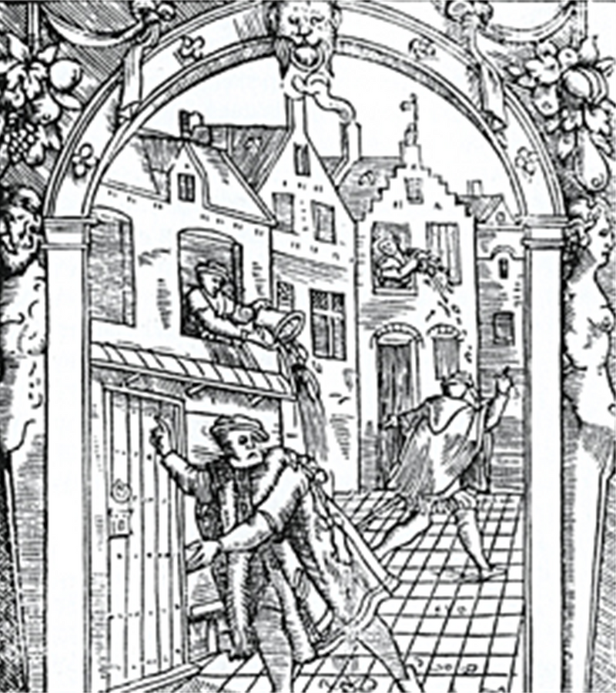
Medieval Streets
The streets were little more than mud tracks with an open drain down the middle. They were incredibly dirty, as people emptied the contents of their chamber pots outside each morning. Animals often roamed the streets. Life generally was very cramped and people lived very close together. This meant that disease could spread very easily.
The History of Europe and the wider World
Chapter Six: The Middle Ages (Norman England)
@MsDoorley

Slide 39
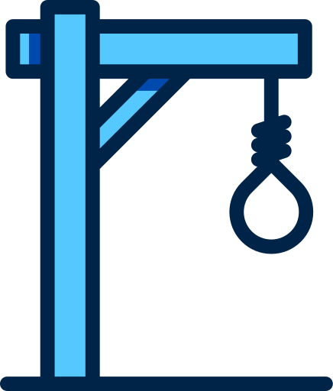
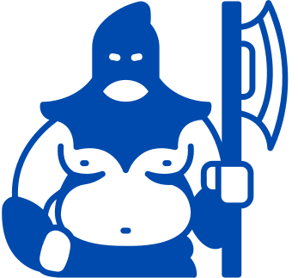
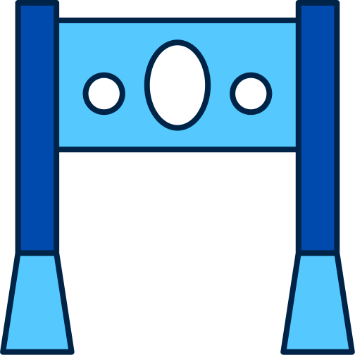
Medieval Crime and Punishment
Crime was common, especially at night. Punishments were extreme:
  A robber would have his hand cut off
  Murderers were hanged in public
  Petty criminals were brought to market square and had their legs locked into stocks, or their head and hands locked into a pillory.
The History of Europe and the wider World
Chapter Six: The Middle Ages (Norman England)
@MsDoorley

Slide 40
Checkpoint (pg. 58, Artefact, 2nd Edition)
  Where were towns built in the Middle Ages and why were they built there?
  How did towns protect themselves?
  Describe a house in a medieval town.
  Explain the following term: charter.
  Why did diseases spread so easily in towns?
The History of Europe and the wider World
Chapter Six: The Middle Ages (Norman England)
@MsDoorley

Slide 41

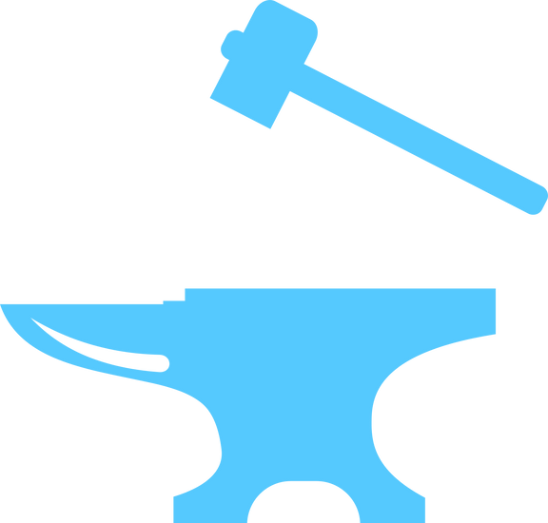

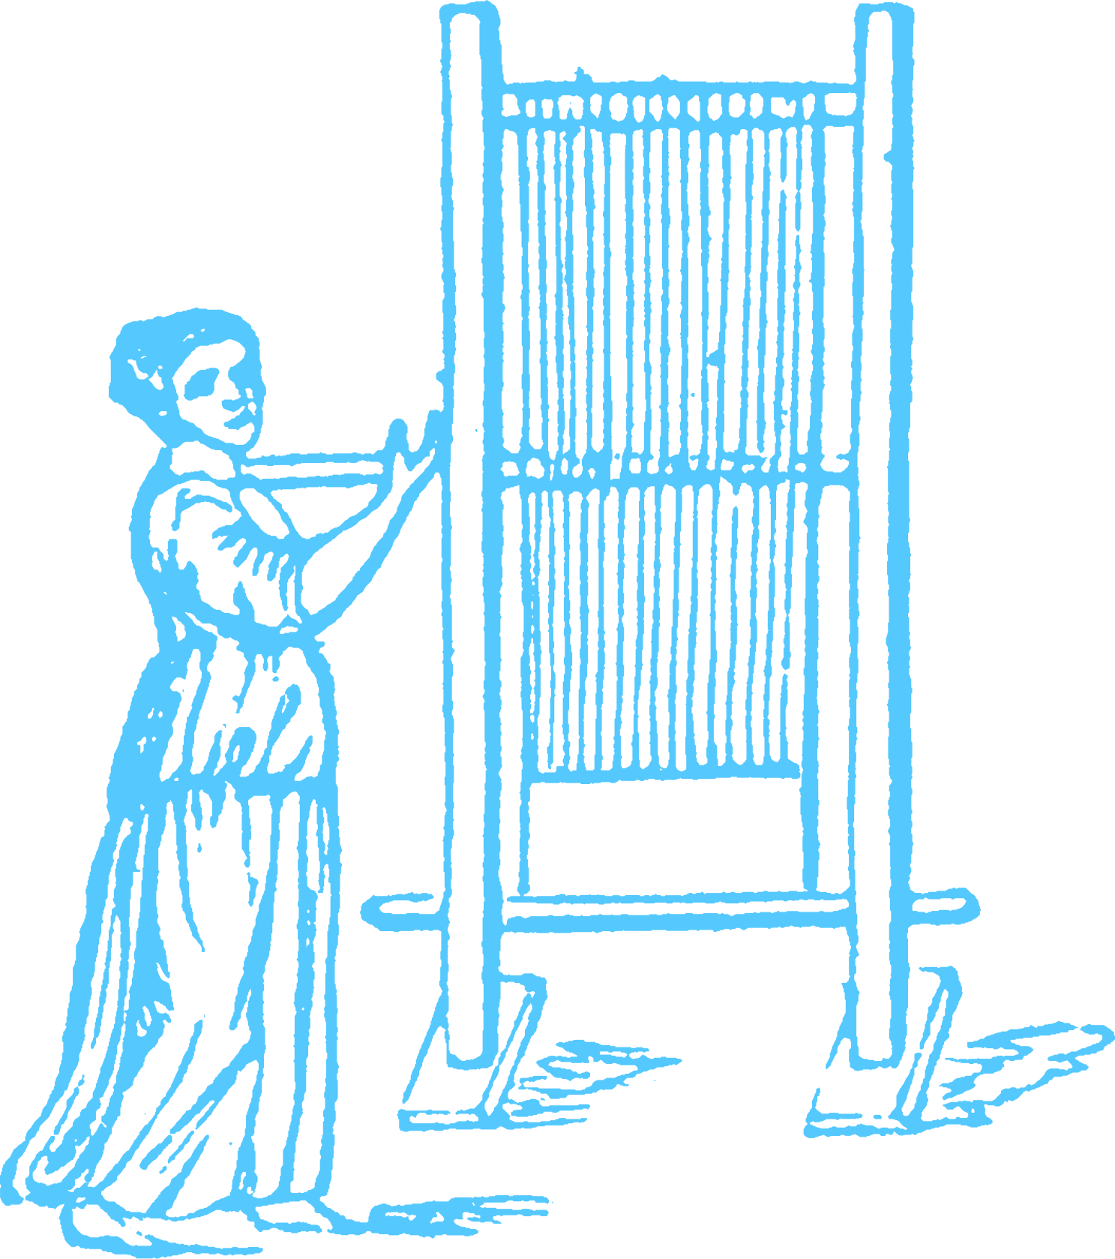

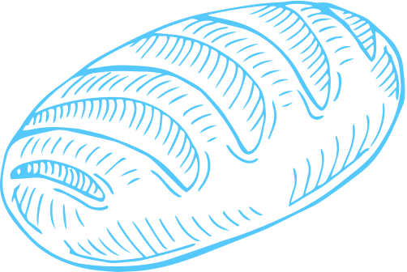


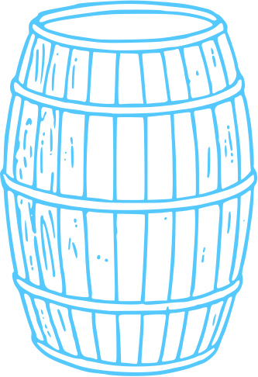

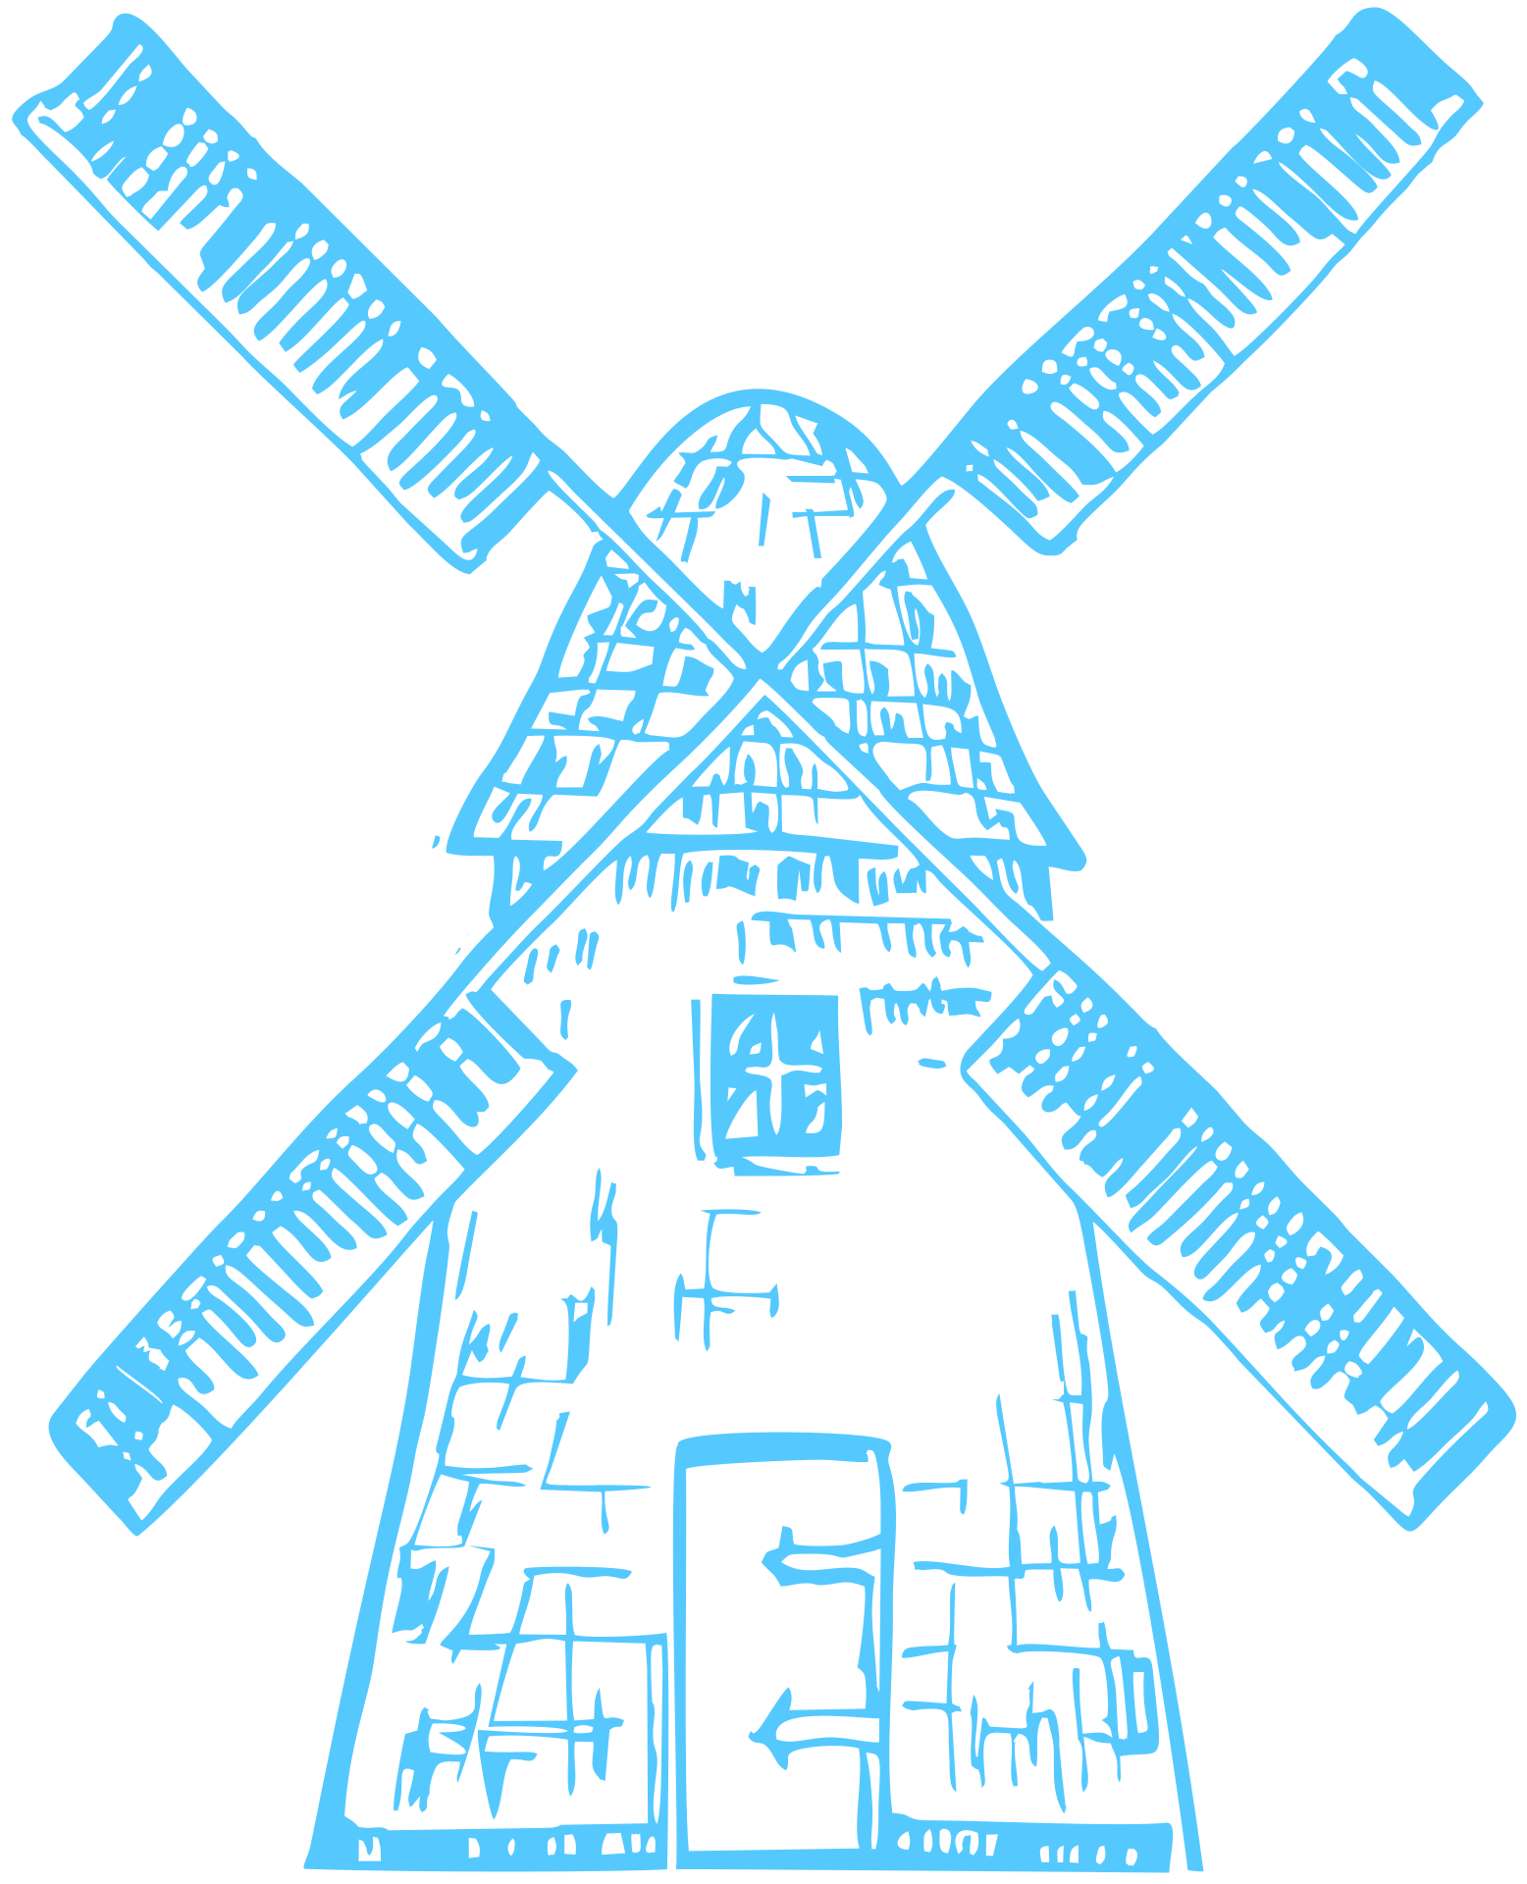
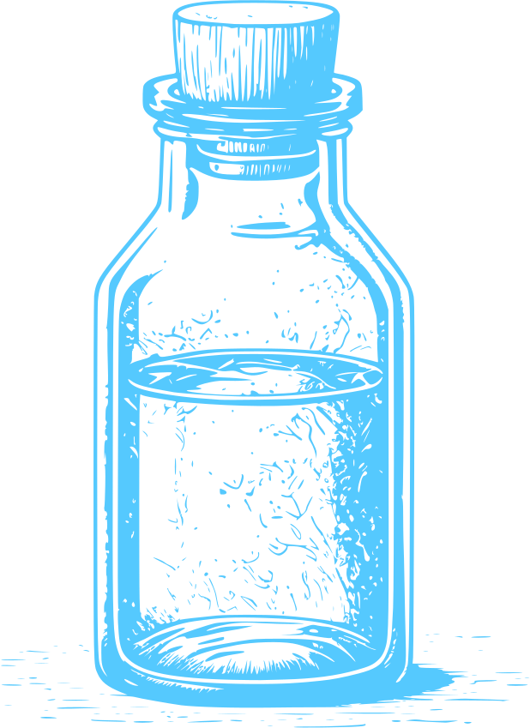
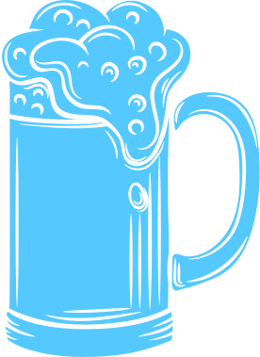
Craftsmen
Craftsmen produced the everyday goods that the town needed, from food to tools to clothes - examples include butchers, bakers, blacksmiths, carpenters, stonemasons, coopers (barrel-makers), weavers and tanners (leather-makers). A craftsman would open a shop on the ground floor of his house. As most people could not read, his shop sign was a picture, not words (for example, a fishmonger might use a fish as a symbol). Shops in the same trade were often found in the same street.
The History of Europe and the wider World
Chapter Six: The Middle Ages (Norman England)
Can you guess which symbol goes with what trade?
@MsDoorley

Slide 42
Craftsmen
The craftsmen of each town formed guilds, organisations of people who worked in the same trade. Guilds charged a fee for membership. A guild set standards for the quality of members' work (you could be fined for substandard work), set prices and wages, decided who could trade in town and cared for old and sick members, and for the families of dead members.
Becoming a master craftsman
Girls were taught by their mothers to cook, clean, make clothes and look after a household. They were often married by the age of twelve to a man their father had chosen. Some girls did train with their fathers to become craftswomen, but this was very rare in Medieval Europe. Most craftswomen were widows who continued on their husband's work to support the family.
Boys usually took up their father's trade. Having begun in his father's workshop, a boy became an apprentice at around twelve. He lived with a master craftsman, slept in the workshop, received no pay and was often treated harshly. After seven years, he became a journeyman. Now he could be paid for his work and could travel to different workshops and towns for work and experience. Eventually, he applied to become a master craftsman. He created a masterpiece (the best example of his work). If the guild decided it was good enough, he was accepted and could open his own workshop, train apprentices and sell his work.
The History of Europe and the wider World
Chapter Six: The Middle Ages (Norman England)
@MsDoorley

Slide 43
Checkpoint (pg. 59, Artefact, 2nd Edition)
  Why did craftsmen use pictures on their signs?
  What were guilds and what did they do?
  Explain how a boy would train to become a master craftsman.
The History of Europe and the wider World
Chapter Six: The Middle Ages (Norman England)
@MsDoorley

Slide 44
AD 476 to 1500
Chapter 6
6.6: RELIGION IN THE MIDDLE AGES
6.6: religion in the middle ages
Strand Three: The History of Europe and the Wider World
@MsDoorley

Slide 45
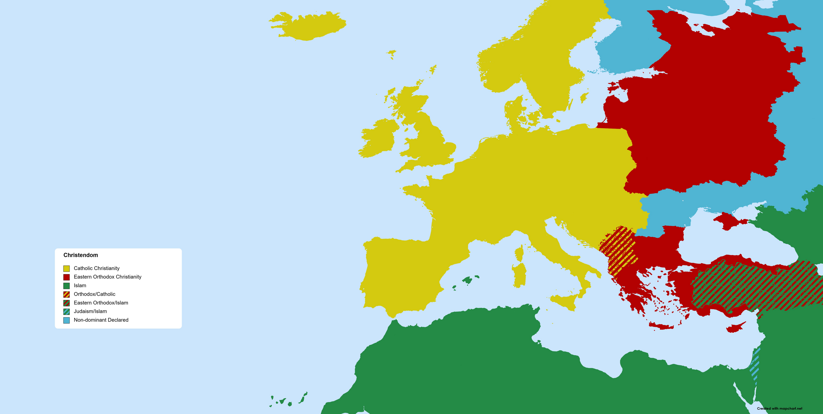
Iceland
Norway
Finland
Sweden
Scotland
North Sea
Baltic Sea
Denmark
Russia
Ireland
England
Poland
The History of Europe and the wider World
Germany
Chapter Six: The Middle Ages (Norman England)
Atlantic Ocean
France
Hungary
Bulgaria
Black Sea
Aragon
Italy
Serbia
Portugal
Byzantine Empire
Castile
Mediterranean Sea
Diagram created with mapchart.net
@MsDoorley

Slide 46
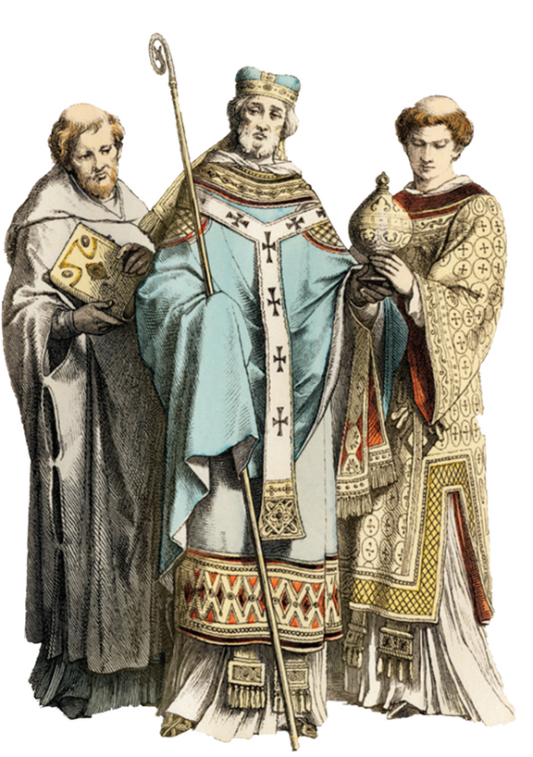
Christendom
Medieval Europe was almost entirely Catholic. Religious belief was very strong and had a huge influence on people's daily lives. Many people lived in constant fear of going to hell if they did not obey the Church's teachings. So important was religion and so powerful was the Catholic Church that Europe was often called Christendom ('kingdom of Christ').
The Pope in Rome was the head of the Catholic Church and was the most powerful ruler in Europe. Europe was divided into dioceses, run by archbishops and bishops, and then into smaller parishes, run by priests. Kings often gave land and money to bishops and this made the Church very wealthy. Bishops would build huge churches called cathedrals in their dioceses to symbolise their power. The most important churchman in Norman England was the Archbishop of Canterbury in London.
The History of Europe and the wider World
Chapter Six: The Middle Ages (Norman England)
Diagram taken from Artefact, 2nd Edition by Eimear Jenkinson and Gregg O'Neill (educate.ie)
@MsDoorley

Slide 47
Life in the Christendom
Christians had always come under attack from pagans and people like the Vikings looking for riches.
In 1054 there was a split (schism) in Christianity, and a new version called Eastern Orthodox church was created. Their leader was called the Patriarch of Constantinople. The Catholic Church remained loyal to the Pope in Rome.
From the 12th century onwards the Catholic church was questioned by some of it’s followers. These were called “heretics” and expelled from the church (excommunicated).
Another schism took place between 1378 and 1417, known as the Great Western Schism. This time, France and Rome disagreed on the pope elected so there was one Pope in Avignon, France and another in Rome. To try to find a solution, the Church then elected a new Pope - meaning that there were THREE POPES ruling at the same time.
Even with all the disagreement, the Church gained huge support in the middle ages. Pilgrimages went to Compostela in Spain, Canterbury in England and even to the Holy Land. Crusades were when Christians set off to convert the Muslims of the Holy Land, even if it meant battle and death. Most of the crusaders never came back.
The History of Europe and the wider World
Chapter Six: The Middle Ages (Norman England)
@MsDoorley

Slide 48
Cathedrals in the Middle Ages
There were two different styles of cathedrals built in the Middle Ages: the older, style, called Romanesque, which was based on Roman architecture and the second type was called Gothic and had come to England with the Normans.
Romanesque Features | Gothic Features
Rounded doorways, arches and windows | Pointed doorways, arches and windows
Fewer and smaller windows | More and larger windows, sometimes with stained glass
Low ceilings | High ceilings
Large pillars | Narrow pillars
Weight of the roof supported by the walls and pillars inside. | Weight of the roof partially supported by flying buttresses on the outside, allowing for fewer pillars, higher ceilings and more windows. The use of the flying buttress was one of the Norman's great architectural innovation.
The History of Europe and the wider World
Chapter Six: The Middle Ages (Norman England)
@MsDoorley

Slide 49
Priests in the Middle Ages
The manor village and town often made up a parish. The local church was one of the few buildings to be made of stone. The local priest was rare in being able to read and write, so he was often asked to help with letters or to advise people on legal problems. Priests were often appointed as secretaries to lords and knights as all writing was in Latin or Greek (language of the Church). The Lord or Knight granted the priest a a glebe (land to live on and farm so he could make a living).
In some places, priests gave children a very basic education focused on the Bible. They said Mass in Latin every Sunday and ensured the local religious holidays were observed. They tended to the sick and presided at marriages, baptisms and funeral ceremonies. As each peasant had to pay the priest a tithe (payment of 10% of the crop), most priests were quite wealthy. They passed on some of their earnings to their bishops, further increasing the wealth of the Church. They helped maintain order by encouraging the people to accept their hard lives and to look forward to getting their reward in heaven.
The History of Europe and the wider World
Chapter Six: The Middle Ages (Norman England)
@MsDoorley

Slide 50
Checkpoint (pg. 61, Artefact, 2nd Edition)
  What was Christendom?
  Explain the structure of the Catholic Church.
  Why was the Church so wealthy in the Middle Ages?
  Why was the priest an important person in manors and towns?
The History of Europe and the wider World
Chapter Six: The Middle Ages (Norman England)
@MsDoorley

Slide 51
Monasteries
Some people wanted to withdraw completely from the world so that they could focus on prayer and being closer to God. They set up monasteries (for men, who became monks) and convents (for women, who became nuns). They were closed communities, separated from the world around them. They lived their lives according to strict rules and spent most of their time praying, fasting and working. An abbot was head of a monastery - or an abbess was head of a convent. Their assistants were the priors.
Monasteries were very important in medieval life. They were the first places to offer education based on ability, regardless of the wealth of their parents. St. Thomas Aquinas founded the Dominicans, St. Robert of Molesme founded the Cistercians while Oxford University was founded by a combination of religious orders.
They provided help to the poor and the sick and offered shelter to travellers. They also copied books in the scriptorium; these monks were called scribes.
The church was looked after by the sacristan. The monks ate in the refectory. The dormitory was a large room where the monks slept. The cloisters were covered walkways for prayer. The monks gathered in the chapter house for readings. In the almonry, the almoner gave aid (alms) to the poor. The infirmary was where the infirmarian looked after the ill of the monastery and nearby community. Guests and travellers could stay in the hostel, which was managed by the hosteller. The monk in charge of the money was the bursar.
Monks who studied the Bible and wrote famous books like Books of Kells.
The History of Europe and the wider World
Chapter Six: The Middle Ages (Norman England)
@MsDoorley

Slide 52
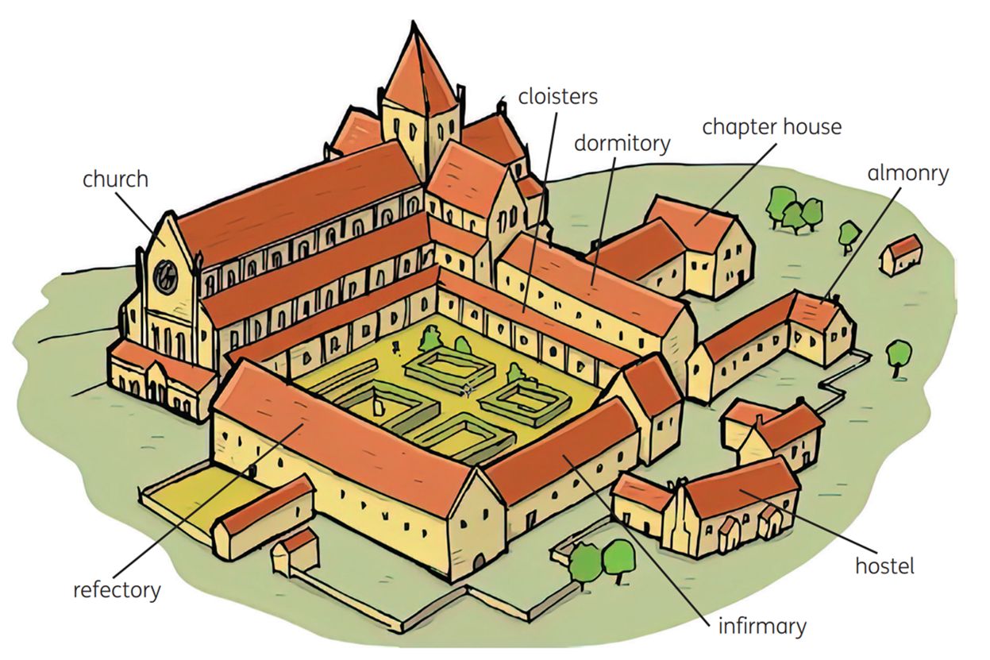
The History of Europe and the wider World
Chapter Six: The Middle Ages (Norman England)
Diagram taken from Artefact, 2nd Edition by Eimear Jenkinson and Gregg O'Neill (educate.ie)
@MsDoorley

Slide 53
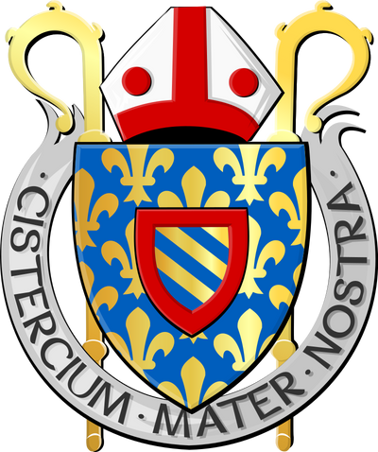
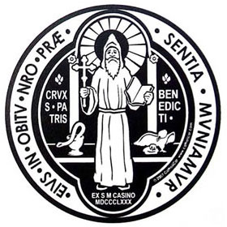
Becoming a monk
There were various monastic orders that monks could join: the Benedictines and the Cistercians were two of the major orders who were withdrawn from medieval society.
A boy who wanted to become a monk would join a monastery as a novice around the age of 15 (though much younger children could be sent). There he was taught to live his life according to the Rule of St Benedict, the strict set of rules that monks had to live by. He learned to read and write in Latin (the language of the Church) and would study Church teachings and history.
After a number of years, if the abbot decided that he was suited to become a monk, he swore his solemn vows of poverty (he could not own anything), chastity (he could not get married) and obedience (he must do what the abbot told him). The crown of his head was then shaved - this was called a tonsure and symbolised the crown of thorns worn by Jesus Christ during the Crucifixion. He would also receive his habit, or monks' garments. He was now a member of a monastic order.
The History of Europe and the wider World
Chapter Six: The Middle Ages (Norman England)
@MsDoorley

Slide 54
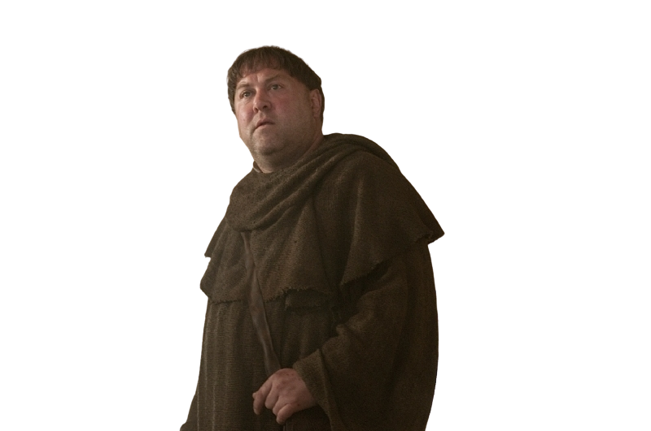
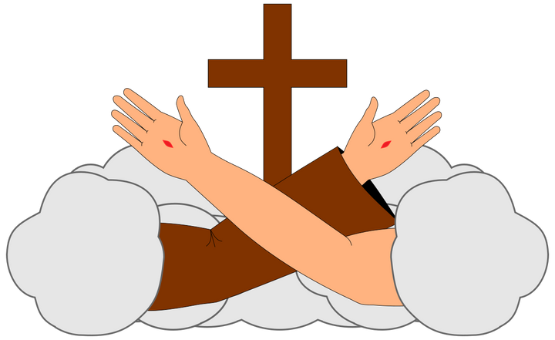
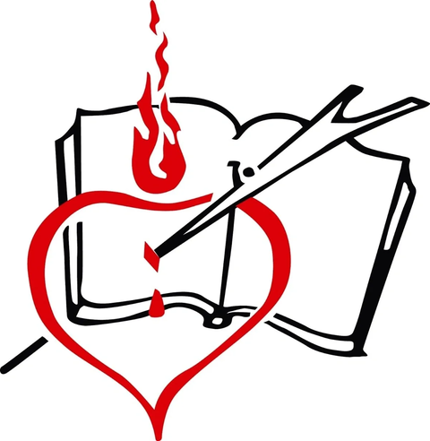
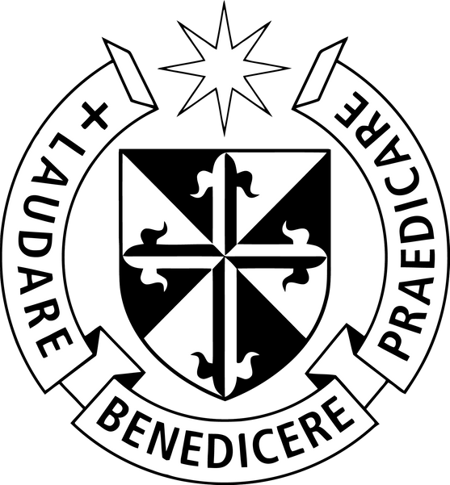
Friars
Some monks preferred to live among the people so that they could better help them. These monks, called friars, travelled around the countryside or set up firaries in towns. They spent their time tending to the poor and the sick. They saw this as following the examples of Jesus' life as told in the Bible. Friar orders such as the Franciscans, the Augustinians and the Dominicans became very popular from 1200 onwards.
The History of Europe and the wider World
Chapter Six: The Middle Ages (Norman England)
@MsDoorley

Slide 55
Checkpoint (pg. 61, Artefact, 2nd Edition)
  Why did people join monasteries and convents?
  Describe the role of the following monks in a monastery: abbot; sacristan; infirmarian; almoner; hosteller; bursar; scribe.
  Where in a monastery would a monk: a) sleep; b) eat; c) walk and pray; d) care for local people who were unwell?
  Why were monasteries so important in medieval life?
  Explain what a novice would do if the abbot accepted him as a monk.
  What is the difference between friars and monks?
The History of Europe and the wider World
Chapter Six: The Middle Ages (Norman England)
@MsDoorley

Slide 56
Checkpoint (pg. 61, Artefact, 2nd Edition)
  People joined monasteries and convents so they could dedicate themselves to the service of God.
  Abbot: head of the monastery; Sacristan: prepared the church for Mass; Infirmarian: looked after the sick; Almoner: gave help to the poor; Hosteller: looked after visitors to the monastery.
  (a) Dormitory: where monks slept; (b) Refectory: where the monks ate; (c) Cloisters: covered walkways where monks could pray in silence; (d) Infirmary: where a monk looked after the sick.
  Monasteries were the first places to offer education to children based on ability, to provide help to the poor and the sick and they also provided places for travellers to stay.
  He would swear vows of chastity, obedience and poverty. The crown of his head would be shaved and he would receive a habit.
  Monks stayed in their monasteries, while friars travelled around serving the poor and the sick.
The History of Europe and the wider World
Chapter Six: The Middle Ages (Norman England)
@MsDoorley

Slide 57
AD 476 to 1500
Chapter 6
6.7: HEALTH AND MEDICINE IN THE MIDDLE AGES
6.7: health and medicine in the middle ages
Strand Three: The History of Europe and the Wider World
@MsDoorley

Slide 58
Medieval medicine
Medieval medicine was based on the writings of the Ancient Greeks which was very different to modern medicine. Their beliefs about the body were very far from modern medicine. Hippocrates, the “Father of Medicine”, believed the body was made up of four humours: blood, black bile, yellow bile and phlegm. If a person was sick, it was due to an imbalance between these humours. They were treated by:
  Bleeding – cutting the patient so that they bled.
  Cupping – placing heated metal cups on the skin to draw fluids to the surface.
  Leeching – using leeches to draw the blood or other fluids out of the body.
  Amputation – cutting off a limb.
Herbal medication was also common, with mixtures of herbs given to the sick. Monasteries specialised in the care of the sick and functioned as the first hospitals.
The History of Europe and the wider World
Chapter Six: The Middle Ages (Norman England)
@MsDoorley

Slide 59
Illness in the Middle Ages
Medieval conditions were cramped and filthy and people lacked the basics of good sanitation or hygiene. Even minor wounds often became infected and the person might lose a limb or even die. People who were poor and did not have a good diet were less able to fight off infections. Filthy streets and polluted water added to the problems faced. Among the diseases widespread in the Middle Ages were: typhoid, leprosy, smallpox, puerperal fever, dysentery and influenza.
Women also faced the added danger of childbirth – midwives would help but usually had no training beyond their experience at previous births. Women could lose a lot of blood and there was no such thing as a blood transfusion back then. If there was a problem, mother and child might both die. Death from infection soon after birth was also common.
The History of Europe and the wider World
Chapter Six: The Middle Ages (Norman England)
@MsDoorley

Slide 60
The Black Death
The worse disease to affect Europe in the Middle Ages was the bubonic plague – also known as the Black Death. This peaked between 1347 and 1350 – killing at least one third of Europe’s population. The plague was carried by fleas which are thought to have first arrived via ship’s rats from the Black Sea area and spread through the European trade routes.
The symptoms included oozing swellings (buboes) all over the body, darkly coloured skin and the filling of the lungs with phlegm. It was extremely contagious and could be contracted by sneezing, spitting or touching dead bodies. It spread quickly in towns and as it worsened, bodies were simply in the street to be collected. This only spread it even faster. Once infected, people had a 70-80% chance of dying within a week.
It led to the first use of quarantine (Italian for forty days) where in Italy, ships were forced to dock for 40 days without disembarking to stop the spread.
People believed it was God’s anger at human sin while others blamed “outsider” groups, such as the Jews, for deliberately infecting the town.
The History of Europe and the wider World
Chapter Six: The Middle Ages (Norman England)
@MsDoorley

Slide 61
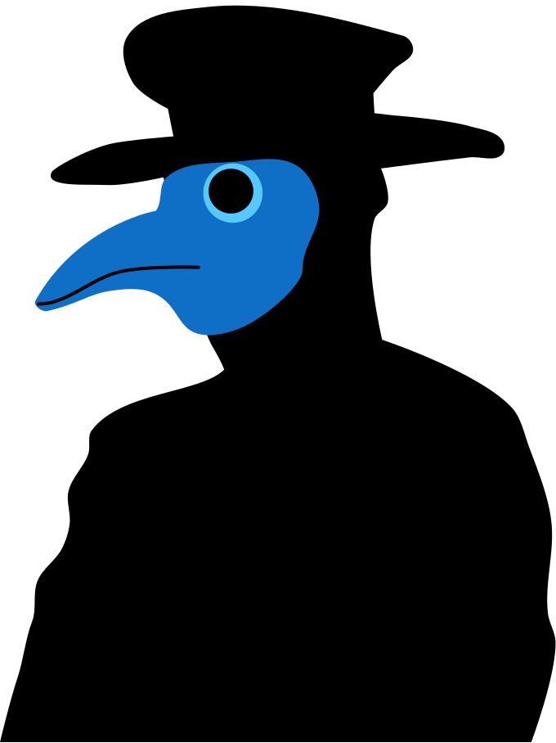

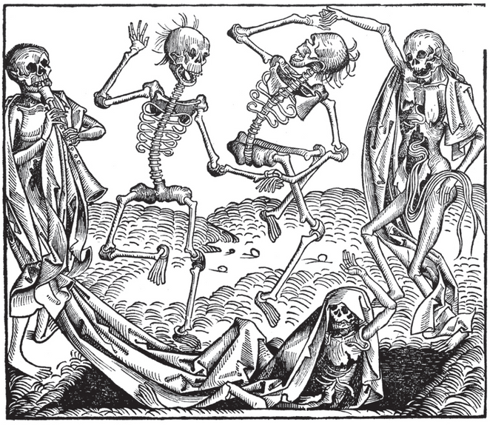
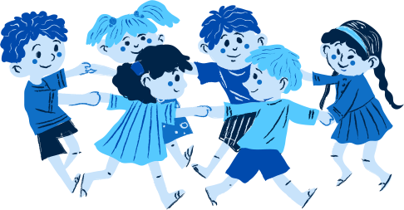
The Impact of the Black Death
Ring a-ring o' roses,
A pocketful of posies.
a-tishoo!, a-tishoo!.
We all fall down.
Ring around the rosey,
A pocketful of posies.
ashes, ashes.
We all fall down.
This alarming costume was worn by doctors trying to fight the lague. Every inch of skin was covered by boots, breeches, gloves, a mask with glass eyes, their doctor's hat and a long overcoat smeared in fat or wax, all in the hope of repelling infection. The beak of the mask was filled with dried flowers and herbs, vinegar or scented oils to mask the stench of the dead and dying.
The History of Europe and the wider World
Chapter Six: The Middle Ages (Norman England)
Picture taken from Artefact, 2nd Edition by Eimear Jenkinson and Gregg O'Neill (educate.ie)
@MsDoorley

Slide 62
The Impact of the Black Death
So many people died within such a short period that Europe was greatly affected by the Black Death
  The feudal system, especially serfdom, declined as many serfs left manors and moved to towns to replace those who had died.
  The peasants who remained on the land were able to demand better treatment from their lords such as a reduction in taxes and more land.
  The failure to find a cure led to doctors questioning their practices – this would lead to big changes in medicine during the Renaissance.
The History of Europe and the wider World
Chapter Six: The Middle Ages (Norman England)
@MsDoorley

Slide 63
Checkpoint (pg. 65, Artefact, 2nd Edition)
  What were medieval medical practices based on?
  What did people believe caused illnesses?
  What were the main treatments for illness in the Middle Ages?
  Why did diseases spread so easily?
  Why was childbirth so dangerous for women?
  What was the Black Death?
  How was it spread?
  What were the symptoms?
  How did people respond to the plague?
  Why did the Black Death lead to better conditions for peasants?
The History of Europe and the wider World
Chapter Six: The Middle Ages (Norman England)
@MsDoorley

Slide 64
Checkpoint (pg. 65, Artefact, 2nd Edition)
  Medieval medical practices were based on the writings of ancient Greek doctors, for example, Hippocrates.
  People believed that an imbalance between the body’s four humours (blood, black bile, yellow bile and phlegm) caused illness.
  The main treatments for illness in the Middle Ages were leeching, bleeding, cupping and amputation.
  People had no idea about cleanliness; they lived close together; towns were very dirty; animals and animal waste were everywhere.
  Midwives usually had no training; women could bleed to death during childbirth or get infections afterwards.
  The Black Death was a plague that swept across Europe from 1347 to 1350, killing one-third of Europe’s population.
  It was spread by fleas, which could be transported long distances quickly on rats, helping the plague to spread from region to region at speed.
  The symptoms were oozing swellings all over the body, darkly discoloured skin and the filling of the lungs with phlegm.
  People responded with prayer, by fasting and beating themselves with whips to repent of their sins and often by blaming minorities in communities, such as the Jews.
  As many peasants died, there were fewer people to work the land. Those who remained demanded better conditions from their lords.
The History of Europe and the wider World
Chapter Six: The Middle Ages (Norman England)
@MsDoorley

Slide 65
AD 476 to 1500
Chapter 6
6.8: THE LEGACY OF THE NORMANS
6.8: the legacy of the normans
Strand Three: The History of Europe and the Wider World
@MsDoorley

Slide 66
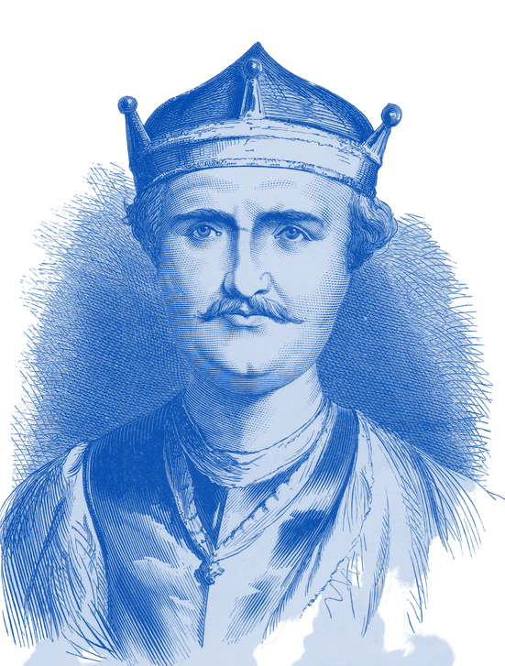
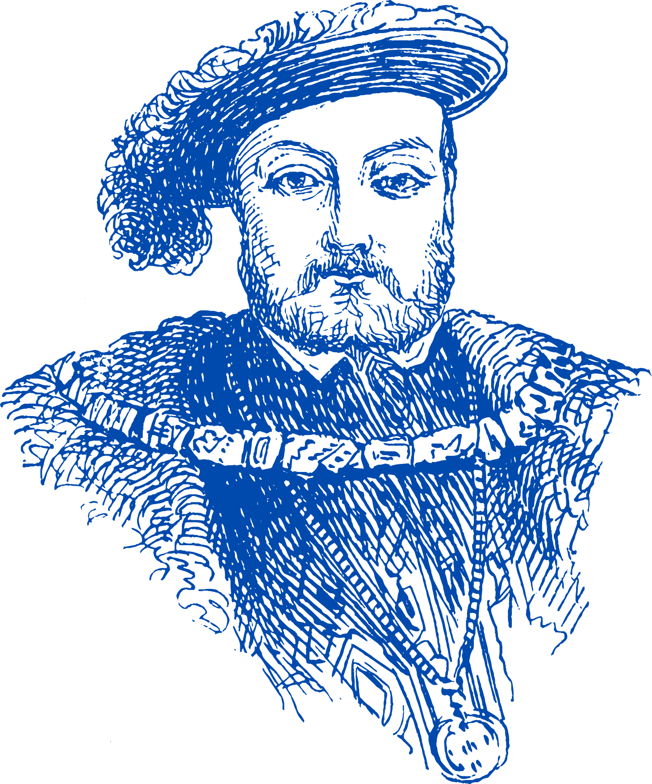
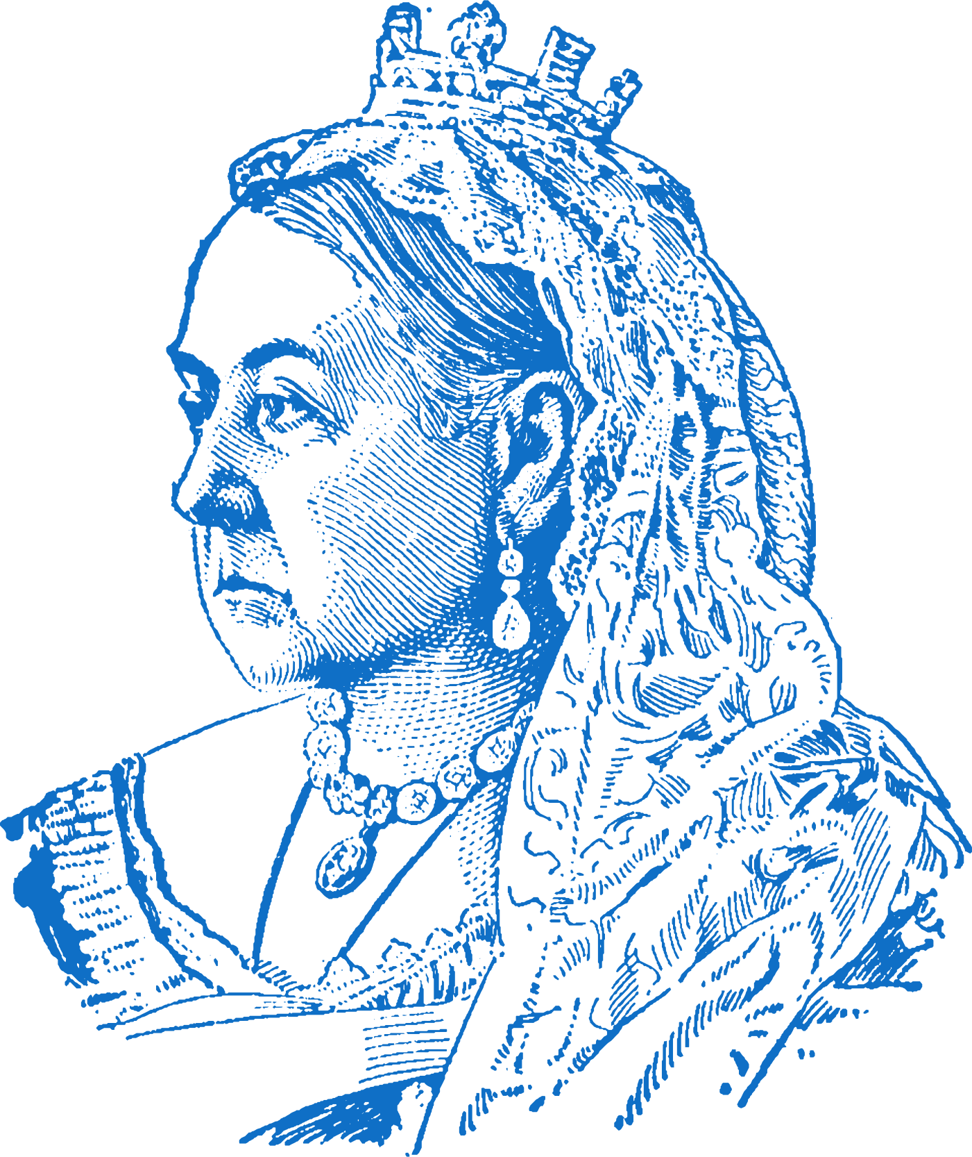
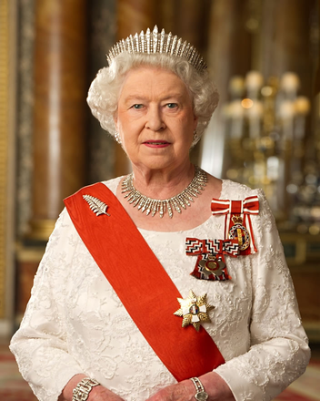
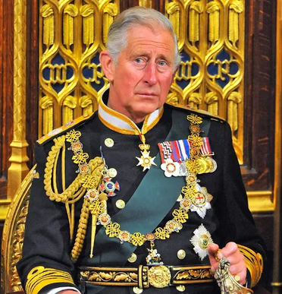
The British Royal Family
When William the Conqueror became King of England, he established a new ruling dynasty (family). All kings and queens of England since then are directly related to him. The current king, Charles III, is 33 generations descended from William, making him his twenty-six times great-grandson. This line of descent makes the Norman Conquest the starting point for many historians in the study of English history and the history of Wales and Scotland which would eventually be joined with England to form the United Kingdom of Great Britain in 1707 (later joining with Ireland in 1801 to form the United Kingdom of Great Britain and Ireland; 1920 saw this union switch to the United Kingdom of Great Britain and Northern Ireland).
The History of Europe and the wider World
Chapter Six: The Middle Ages (Norman England)
William the Conqueror; Henry VIII; Victoria; Elizabeth II; Charles III
@MsDoorley

Slide 67
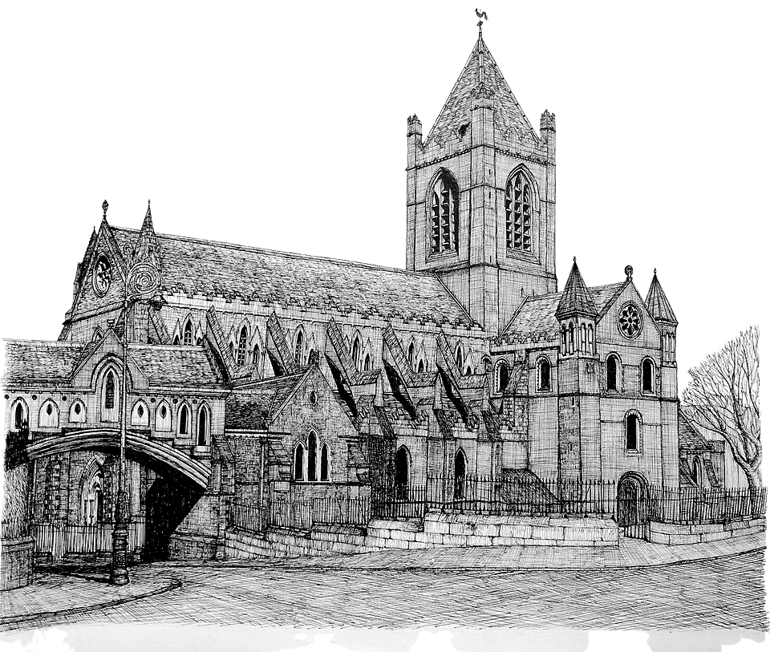
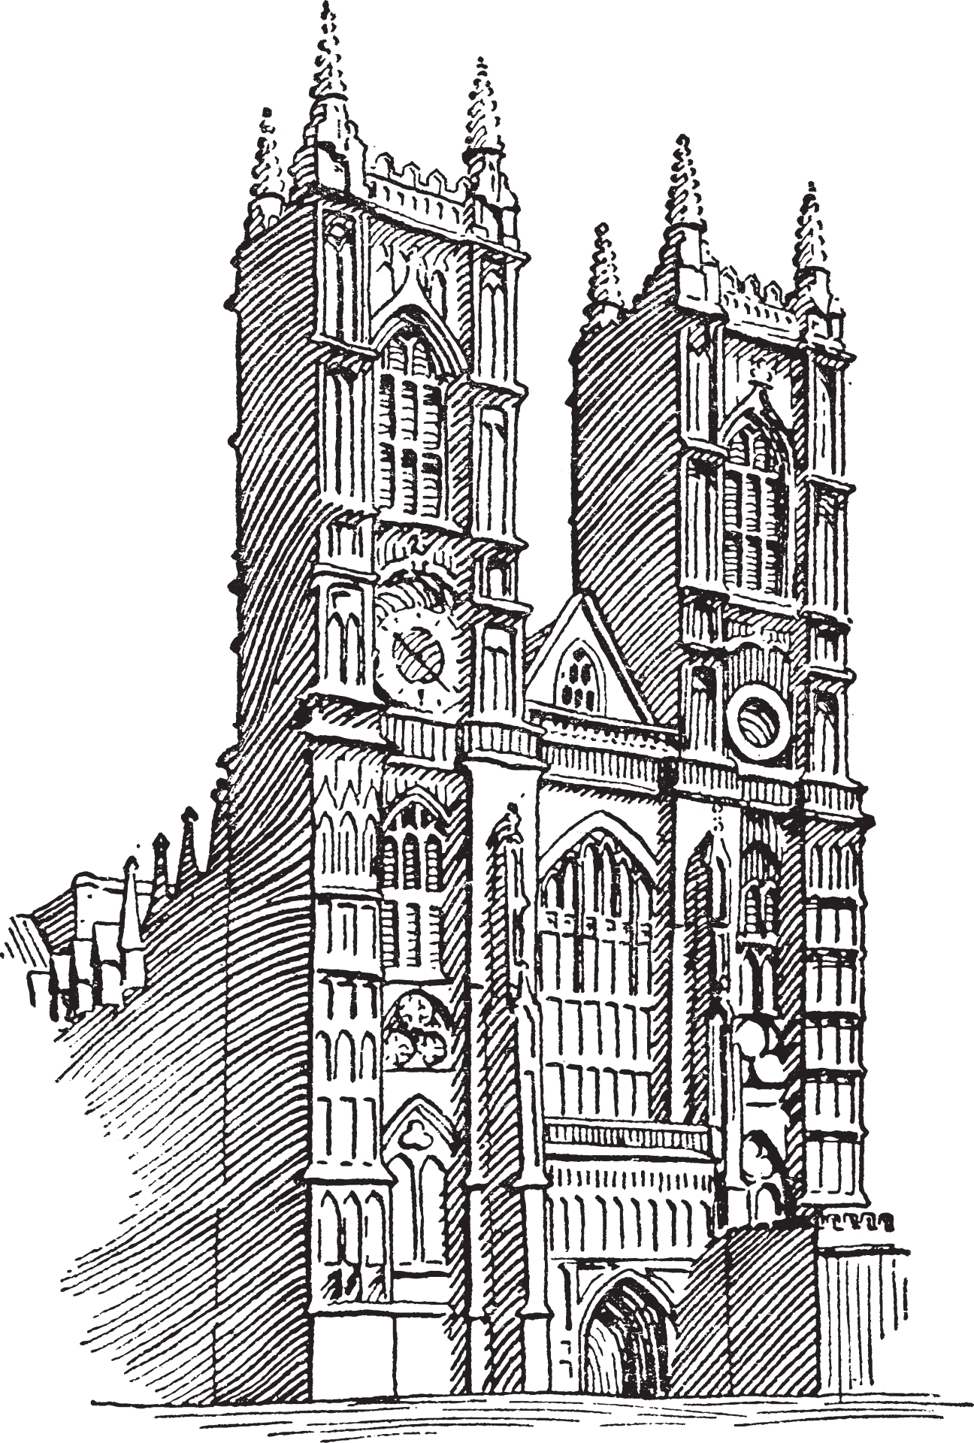
Architecture
The Normans made significant contributions to architecture across England and Ireland. They built stone castles, which became the focus of many English towns and cities. They also introduced the Romanesque and Gothic styles into church building, meaning that much bigger buildings and roofs could be built. Westminster Abbey in London and Christ Church Cathedral in Dublin are examples of Cathedrals with both Romanesque and Gothic features.
The History of Europe and the wider World
Chapter Six: The Middle Ages (Norman England)
@MsDoorley

Slide 68


















Language
After 1066, French became the language of government in England, as Normans replaced the native English nobility. As a result of this, French hugely influenced the development of the English language. While a Germanic language in origin, there are over 10,000 words in modern-day English have their roots in French.
Modern-day Germanic Languages: German, Dutch, Luxembourgish, Norwegian, English/British Icelandic, Faroese, Danish, Swedish
The History of Europe and the wider World
Chapter Six: The Middle Ages (Norman England)
Modern-day Celtic Languages: Welsh, Scottish Gaelic, Gaeilge, Manx
Modern-day Romance Languages: French, Romanian, Italian, Spanish, Portuguese
@MsDoorley

Slide 69






European History
The Normans did not just conquer England. They were considered the best warriors in medieval Europe, and Norman knights played important parts in many wars and battles. Sometimes they fought for their own lords, or sometimes they hired themselves out as mercenaries (fighting for anyone who could pay them). Eventually, different Norman lords and princes would rule lands across Europe and the Mediterranean. Their most important military involvements were the Crusades. Beginning in 1095 and ending in 1291 with the Fall of Acre in modern-day Israel, the Crusades were a series of nine invasions of the Middle East by European Christians to try to seize control of the Holy Land from its Muslim rulers.
The History of Europe and the wider World
Chapter Six: The Middle Ages (Norman England)
First Crusade | Second Crusade | Third Crusade | Fourth Crusade | Fifth Crusade | Sixth Crusade | Seventh Crusade | Eighth Crusade | Ninth Crusade
1096-1099 | 1144-1155 | 1187-119 | 1202-1204 | 1212 | 1217-1221 | 1228-1254 | 1270 | 1271-1272
@MsDoorley

Slide 70
Checkpoint (pg. 65, Artefact, 2nd Edition)
  How is the British Royal Family connected to the Normans?
  How did the Normans advance architectural techniques?
  In what ways did the Norman conquest of England affect the language of the people?
  What evidence is there that the Normans were a major force in the Middle Ages?
The History of Europe and the wider World
Chapter Six: The Middle Ages (Norman England)
@MsDoorley

Slide 71
AD 476 to 1500
Chapter 6
4.6: SUMMARY
4.6: summary
Strand Three: The History of Europe and the Wider World
@MsDoorley

Slide 72
In this chapter, we have learned that...
  The Normans conquered England in 1066 and introduced the feudal system.
  Life in the Middle Ages was very tough. The society built on the feudal system meant that the large majority of the population were kept as peasants.
  People lived in towns, monasteries, castles and manors in the country side.
  War was a constant presence in people’s lives in the Middle Ages.
  Young noblemen were brought up to be knights.
  Religion was central to people’s lives. The Pope was Europe’s most powerful ruler, and bishops and monasteries were very wealthy.
  Death and illness were encouraged by the dirty conditions that most people lived in. There was little understanding of how the body worked or how disease was spread. Their dirty conditions that most people lived in encouraged illness and death. There was little understanding of how the body worked or how diseases were spread.
Strand Three: The History of Europe and the Wider World
Chapter Six: The Middle Ages (Norman England)
@MsDoorley

Slide 73
Reflecting on... Norman England
The Normans profoundly changed Europe during the Middle Ages. Emerging from northern France, Norman lords eventually ruled over large areas of the European continent and the Mediterranean world. They influenced buildings, languages and the system of rule. Their most significant conquest was almost certainly that of England in 1066. They created a unified English state, whose modern-day royal family are their direct descendants. Norman feudal England was profoundly altered by the Black Death.
Strand Three: The History of Europe and the Wider World
Chapter Six: The Middle Ages (Norman England)
@MsDoorley

Slide 74
Examination Questions
2022 SEC Q1g
2023 SEC Q1e, Q1f
Strand Three: The History of Europe and the Wider World
Chapter Six: The Middle Ages (Norman England)
@MsDoorley

Slide 75
Project
Guidelines:
  Length: The depth of your project should reflect about 2-3 weeks of work.
  Sources: Use at least three different sources for your research. These can be books, scholarly articles, or reputable online resources.
  Citations: All information and images that are not your own should be properly cited.
  Mediums: You may choose to present your project in one of the following ways:
    Poster: Your poster should be informative and visually engaging.
    Minecraft or Lego Model: If choosing this option, please also include a brief report explaining your model.
    Painting/Drawing: Your artwork should be accompanied by a description.
    Recycled Materials: Create your model using recycled materials and provide an explanation of your creative process.
Assessment:
Your projects will be assessed based on:
  Research and Content
  Creativity and Presentation
  Understanding of Context
  Adherence to Guidelines
Strand Three: The History of Europe and the Wider World
Chapter Six: The Middle Ages in Norman England
@MsDoorley

Slide 76
Project
Historical Sites
Historical Figures
Tower of London, London
York Minster, York
Warwick Castle, Warwickshire
Canterbury Cathedral, Kent
Bodiam Castle, East Sussex
Charlemagne
Eleanor of Aquitaine
Christine de Pizan
Marco Polo
William the Conqueror
Richard the Lionheart
Joan of Arc
Hildegard of Bingen
Dante
Strand Three: The History of Europe and the Wider World
Chapter Six: The Middle Ages in Norman England
Or another topic of your choosing relating to this chapter.
@MsDoorley

